Slide 1
Chapter 11
Multi-Step Tumorigenesis
Dec 1, 2023
Notes:
具体肿瘤发生总是经历多步骤，包括 oncogene激活+tumor suppressor灭活，其中有genetic alterations 也有 epigenetic alterations

Slide 2
Outline of this lecture
1, Cancer incidence vs age;
2, Multi-step tumor progression (Colon cancer as model);
3, Cancer stem cell and cancer evolution models;
4, Genetic collaborations in cell transformation;
5, Tumor initiator (genetic alteration) and promoter (non-genetic alteration);
6, Inflammation and cancer (Aspirin, cox-2, Prostaglandin etc.);

Slide 3
Overview of Cancer Initiators and promoters
Genetic alteration
Normal cell
Tissue microenvironment
Cancer cell
Epigenetic alteration
Mutations
Histone modification
Genetic alteration
Copy number alterations
Epigenetic alteration
DNA modification
Chromosomal abnormity
Chromatin structure alterations
O₂ and other nutrient supply
Tissue microenvironment
Cytokine, growth factors
Inflammation and immunity

Slide 4
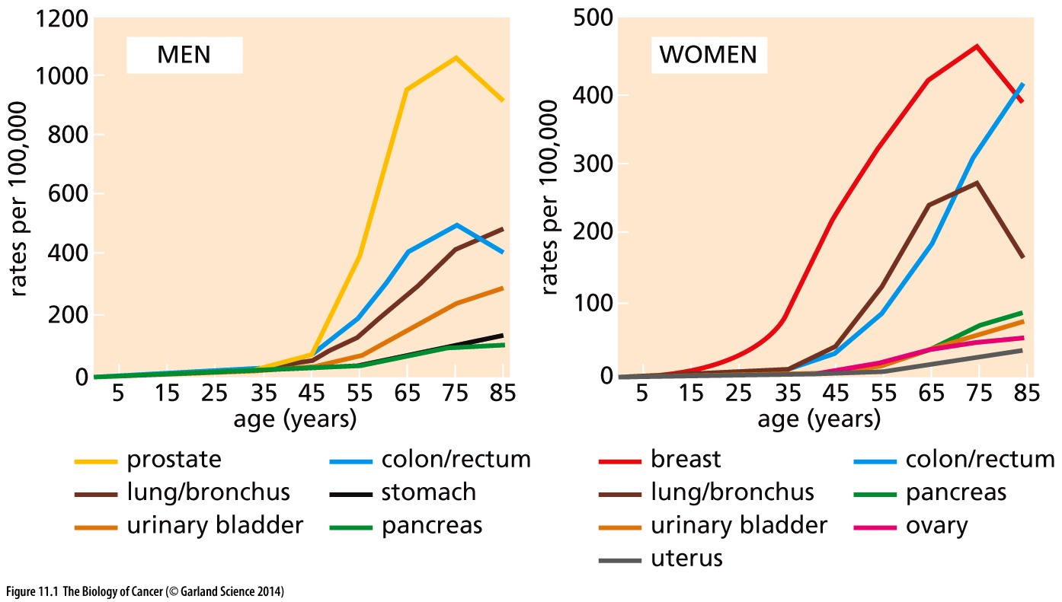
Figure 11.1 Cancer incidence at various ages
Why very old people have relatively less cancer frequency?
These graphs of diagnoses of various types of epithelial cancers show a steeply rising incidence with increasing age, indicating that the process of tumor formation generally requires decades to reach completion.
Notes:
普通癌症，如肺癌，乳腺癌年龄越大，发病率越高，但是非常老的个体，癌症发病率下降。

Slide 5
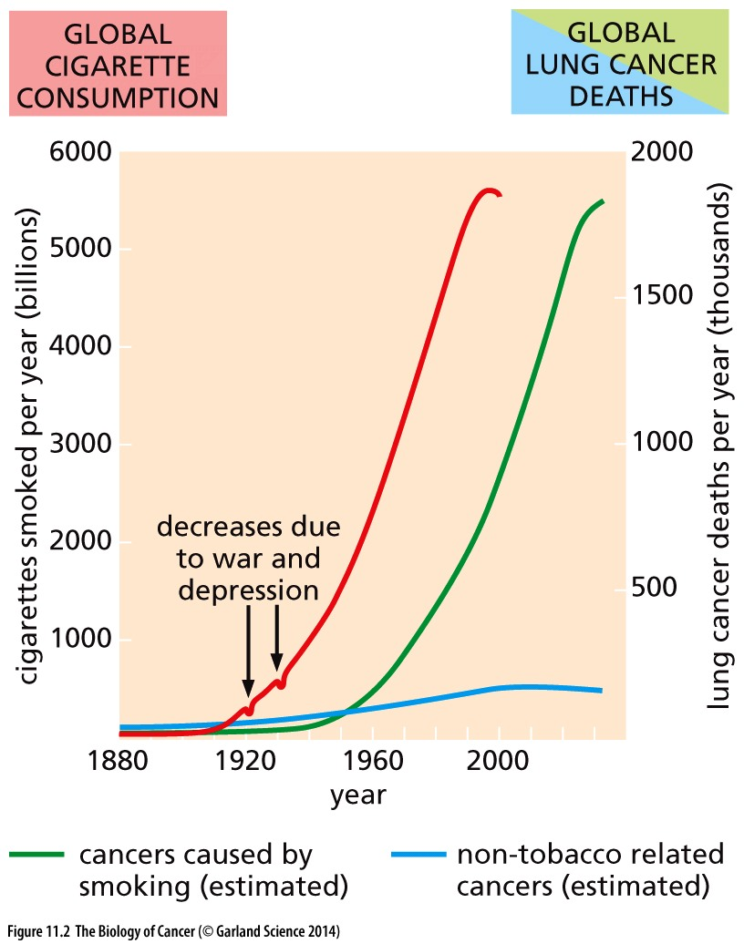
Figure 11.2 Cigarette consumption and lung cancer
These curves compare the annual global consumption of cigarettes (red curve) with the recorded and predicted annual worldwide mortality from lung cancer (green curve).
Genetic alteration
Normal cell
Tissue microenvironment
Cancer cell
Epigenetic alteration
Notes:
群体统计学证据表明：吸烟 和 肺癌 发生有大约 30年的时间间隔

Slide 6
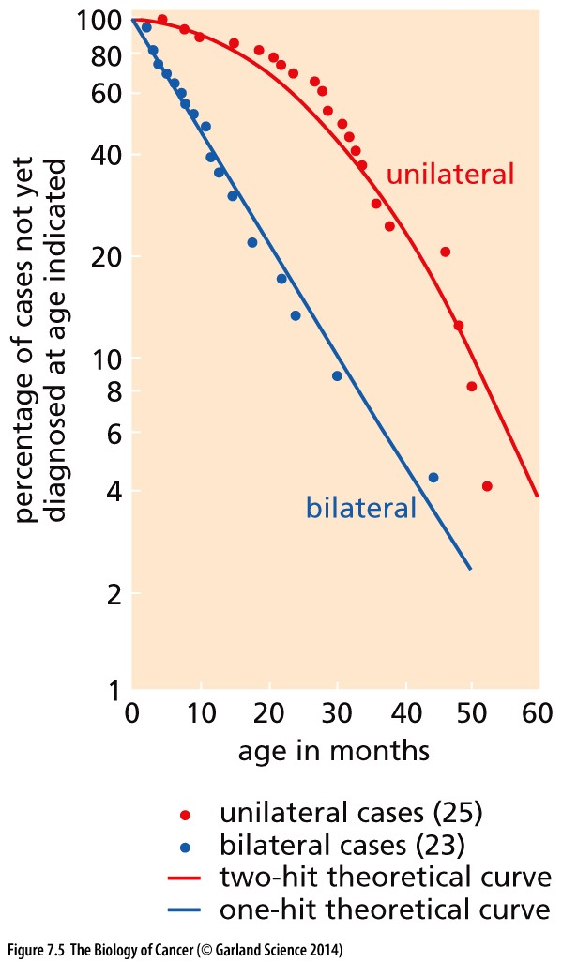
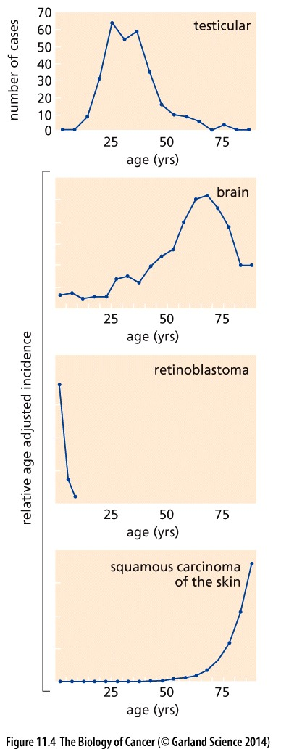
Figure 7.5 Kinetics of appearance of unilateral and bilateral retinoblastomas
Alfred Knudson Jr. studied the kinetics with which bilateral and unilateral retinoblastomas appeared in children. He calculated that the bilateral cases (tumors in both eyes) arose with one hit kinetics, whereas the unilateral tumors (affecting only one eye) arose with two-hit kinetics. Each of these hits was presumed to represent a somatic mutation. The fact that the two-hit kinetics involved two copies of the Rb gene was realized only later.
In 1971
Notes:
著名的two-hit hypothesis，统计肿瘤发病趋势，数学建模，寻找背后的发病因素。

Slide 7
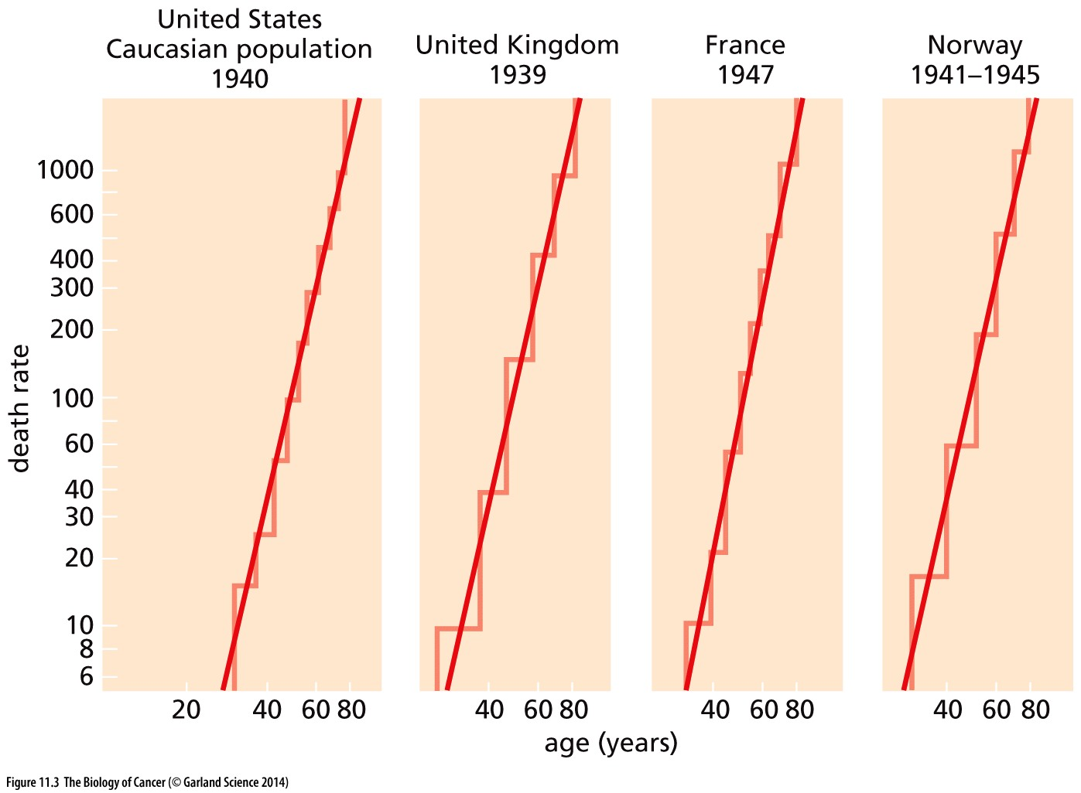
Figure 11.3 Age at death from various epithelial cancers
These log–log plots of male cancer death rates (deaths per 100,000 population,ordinate) at different ages have a slope indicating that completion of five or six rate-limiting events is required to produce a lethal cancer. Interestingly, these slopes are remarkably similar among different countries. The slopes differ slightly with different types of cancer.
Notes:
Cancer发病因素理论数学建模，retinoblastoma算是简单肿瘤，理论上只需要2个hit，常见癌症如 肺癌，肝癌，乳腺癌都是复杂肿瘤，理论计算表明需要5-6个hit.

Slide 8
Figure 11.4 Cancer incidence as a function of age
These graphs indicate that a subset of cancers show age-dependent incidence rates that vary dramatically from the kinetics of appearance of most common cancers. With the exception of testicular cancer, the ordinates in all cases represent incidence relative to the highest incidence rate. Squamous cell skin carcinoma is included to illustrate the incidence kinetics of a cancer that is more typical of adult-onset neoplasias.

Slide 9
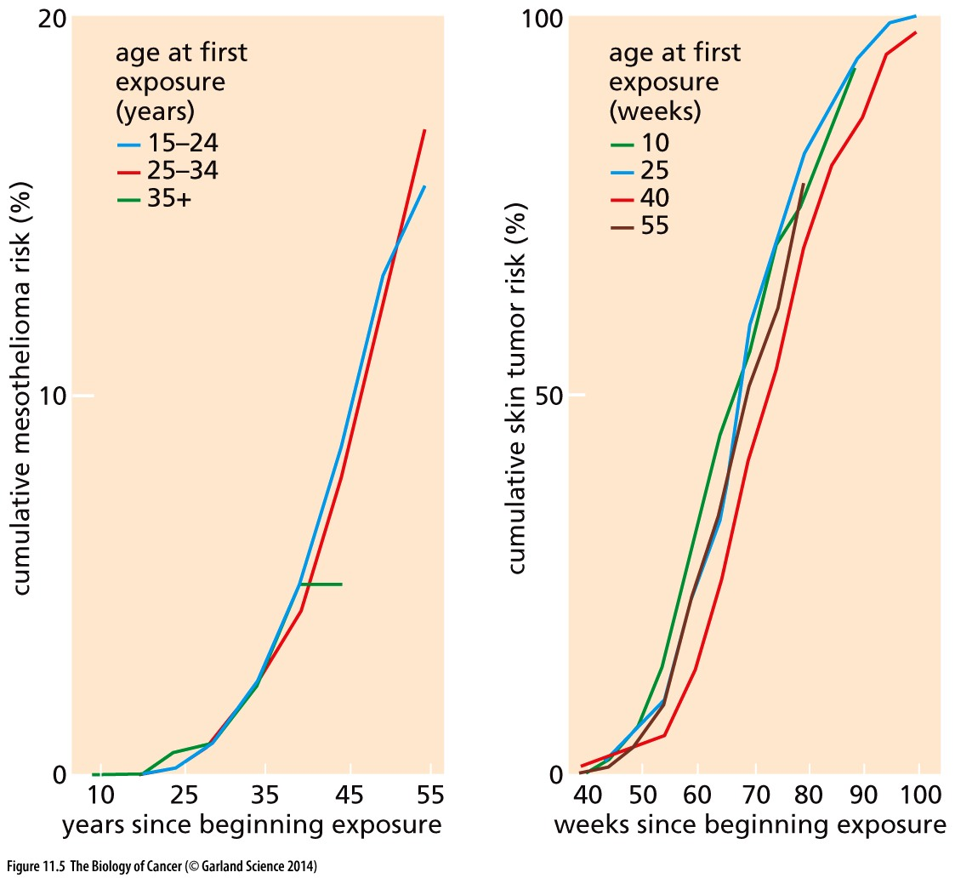
Figure 11.5 Cancer incidence and carcinogen exposure
These graphs indicate that cumulative exposure to a carcinogenic stimulus, rather than the age at which this exposure began, determines the likelihood of developing a detectable tumor. The left graph presents the cumulative risk of developing mesothelioma (a tumor of the mesodermal lining of the abdominal organs and the lungs) among insulation workers in the United States, many of whom were occupationally exposed to asbestos. The right graph presents the cumulative risk of developing a skin tumor among mice treated in an experimental protocol for inducing squamous cell carcinomas of the skin.

Slide 10
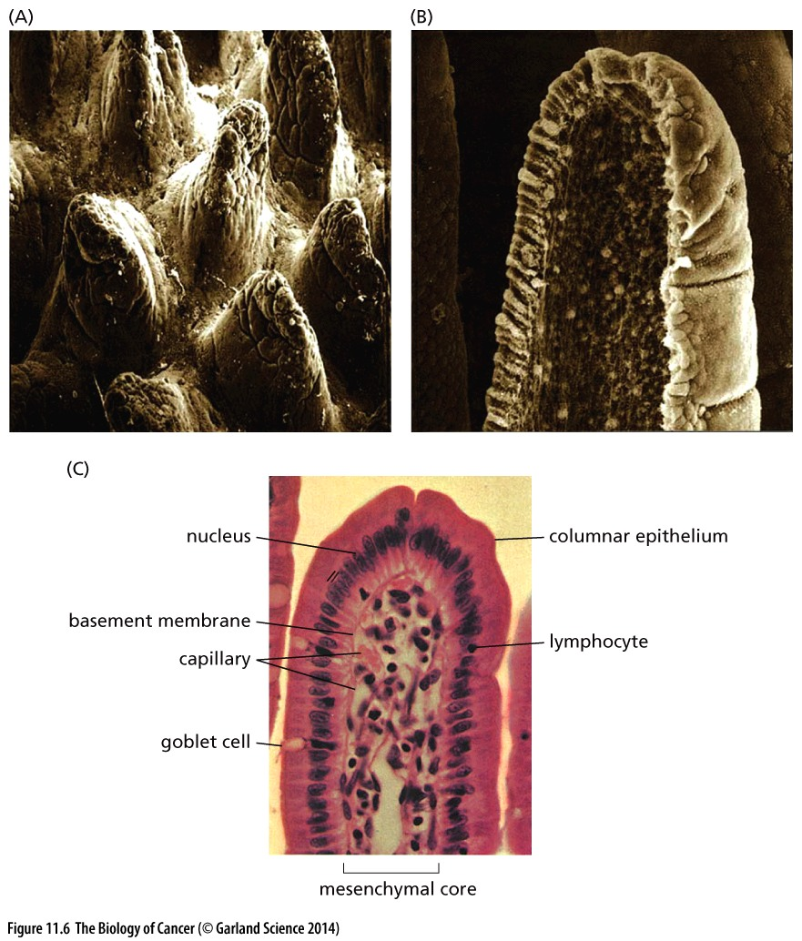
Figure 11.6 Microanatomy of the normal intestinal wall
The organization of the epithelial cells lining the small intestine and the large intestine (colon) is very similar. However, the protruding villi visualized here are present only in the small intestine. (A) This scanning electron micrograph of epithelium of the small intestine shows villi (fingers) of the intestinal mucosa extending into the lumen at regular intervals. (B) Each villus is covered with a layer of epithelial cells. (C) The core of each villus, which is separated from the overlying epithelium by a basement membrane, is composed of various types of mesenchymal cells, including fibroblasts, endothelial cells, pericytes, and various cells of the immune system.

Slide 11
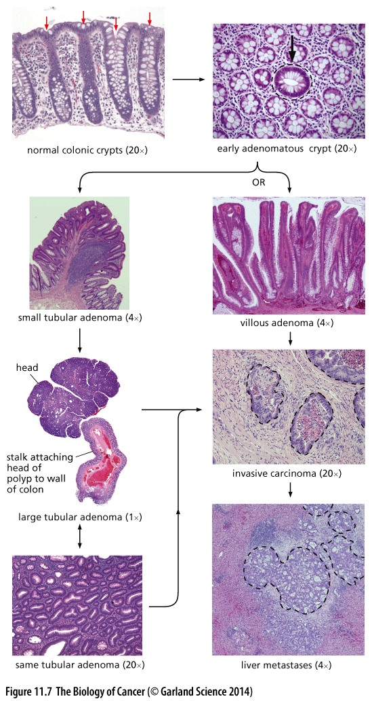
Figure 11.7 Histopathological alterations of the human colon
Notes:
病理切片HE染色图片，显示colon cancer的发生和演变历程, tabular,平坦的

Slide 12
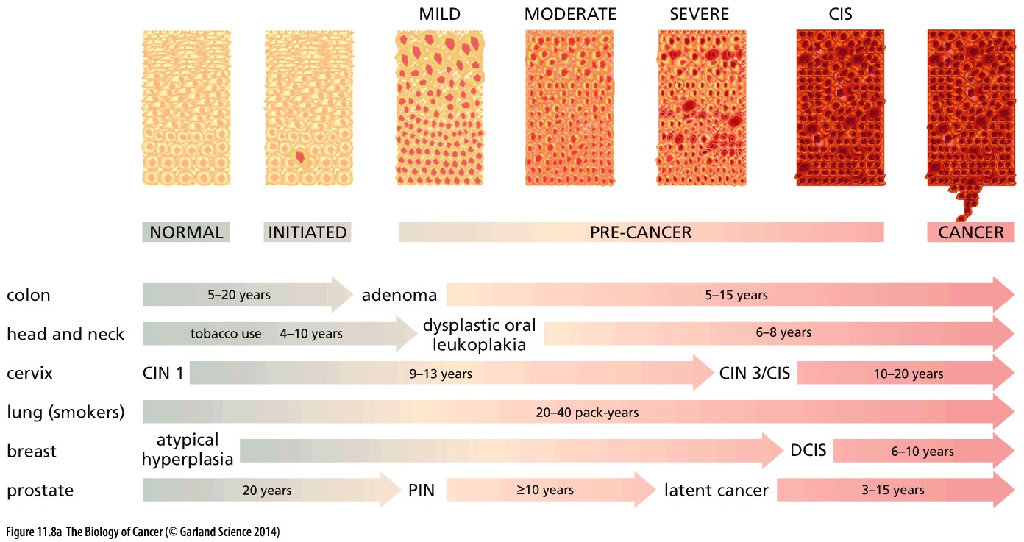
Figure 11.8 Multi-step tumorigenesis in a variety of organ sites
(A) The pathogenesis of carcinomas is thought to be governed by very similar biological mechanisms operating in a variety of epithelial tissues. Accordingly, multistep tumorigenesis involving similar histological entities has been proposed to progress along parallel paths in these various organ sites. These similarities are obscured by the fact that the nomenclature is quite variable from one tissue to another. CIS, carcinoma in situ; CIN, cervical intraepithelial neoplasia; DCIS, ductal carcinoma in situ; PIN, prostatic intraepithelial neoplasia.

Slide 13
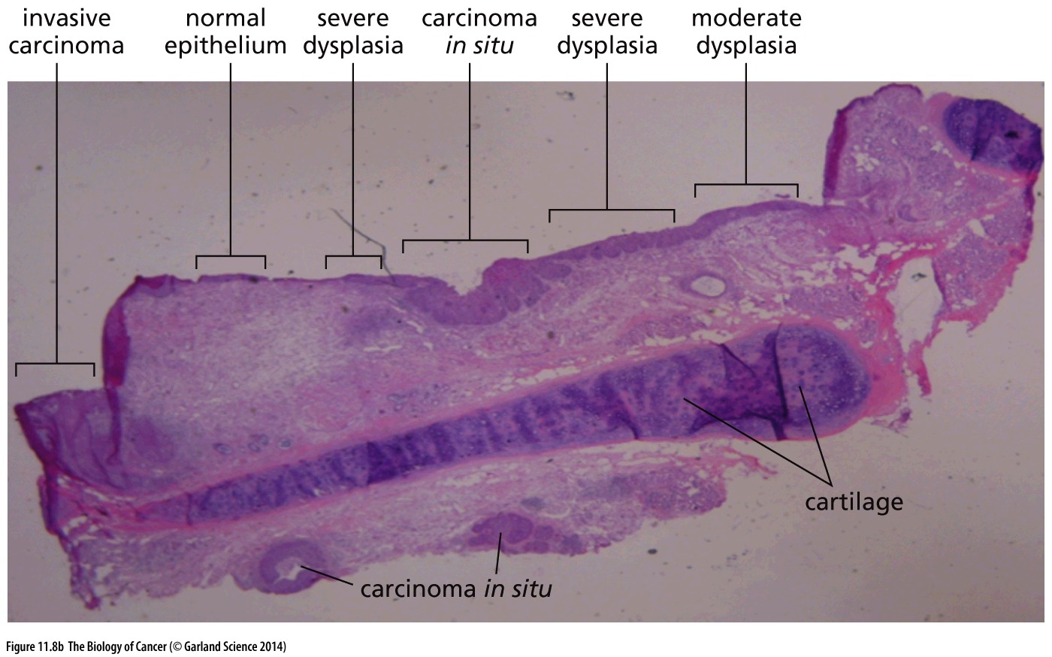
Figure 11.8 Multi-step tumorigenesis in a variety of organ sites
(B) Because more aggressive growths often overgrow their more benign precursors, it is rare to see the multiple states of tumor progression coexisting in close proximity, as is the case in this lung carcinoma. Importantly, while the close juxtaposition of the aberrant growths suggests some relationship among them, an image like this provides no definitive evidence of precursor–product relationships between these various abnormal tissues.

Slide 14
11.3 Cells accumulate genetic and epigenetic alterations as tumor progression proceeds
Colon cancer as a model, because colonic epithelium is, as mentioned, relatively accessible through colonoscopy (结肠镜); because colon cancer is a common disease in the West, making it relatively easy to collect and study large numbers of samples of premalignant and malignant growths;

Slide 15
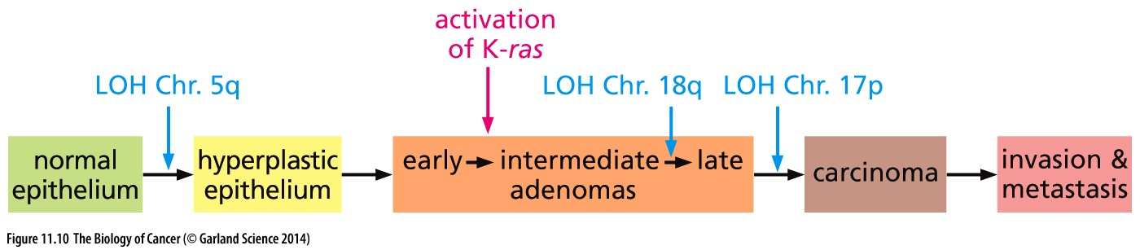
Figure 11.10 Colon tumor progression and loss of heterozygosity in various chromosomal arms
DNA from tissue samples representing various stages of colon cancer progression was analyzed for loss of heterozygosity (LOH) by examining the behavior of chromosomal markers present on the long and short arms of most chromosomes.
Notes:
Colon cancer演变历程，染色体层次分析，尤其LOH分析

Slide 16
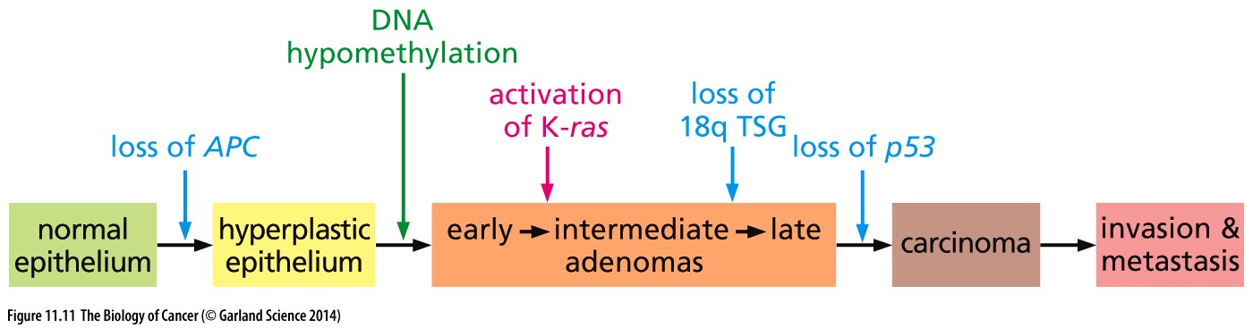
Figure 11.11 Tumor suppressor genes and colon carcinoma progression
Each of the chromosomal regions that underwent loss of heterozygosity (LOH) was considered to harbor a tumor suppressor gene (TSG) whose loss provided growth advantage to evolving pre-neoplastic colonic epithelial cells.
Notes:
Colon cancer演变历程，分子层次分析，APC…

Slide 17
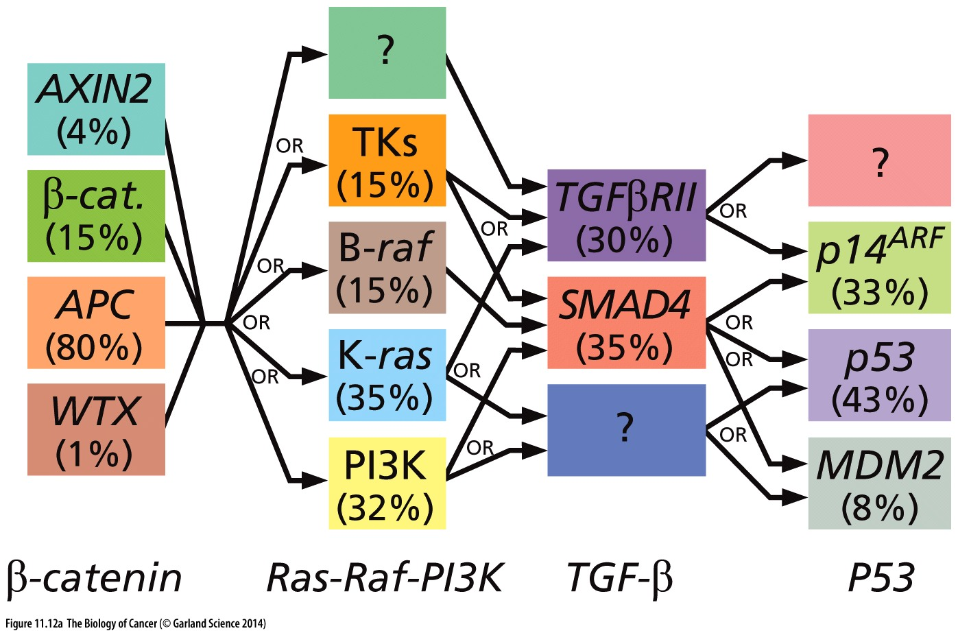
Figure 11.12 Alternative paths during cancer progression
Colon cancer progression
Notes:
目前肿瘤基因组研究会给出更详细的信息

Slide 18
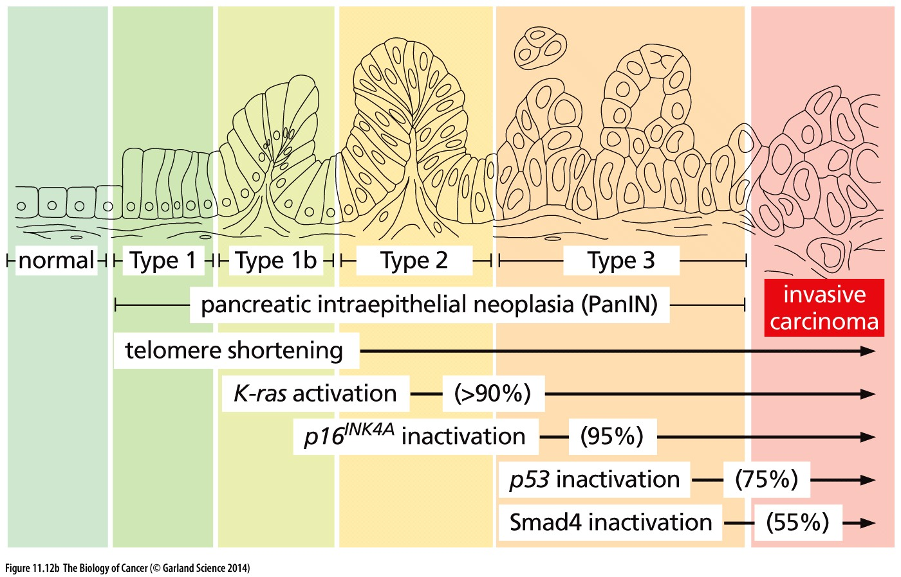
Figure 11.12 Alternative paths during cancer progression
The most orderly succession of genetic and epigenetic changes documented to date occurs during the development of common adenocarcinomas of the pancreas
Notes:
肿瘤突变发生过程现在尚无定论，很多结论也只是推测，只能是说代表了目前的主流学术观点。至于真的情况如何，还得依赖最新生物技术，手段应用。

Slide 19
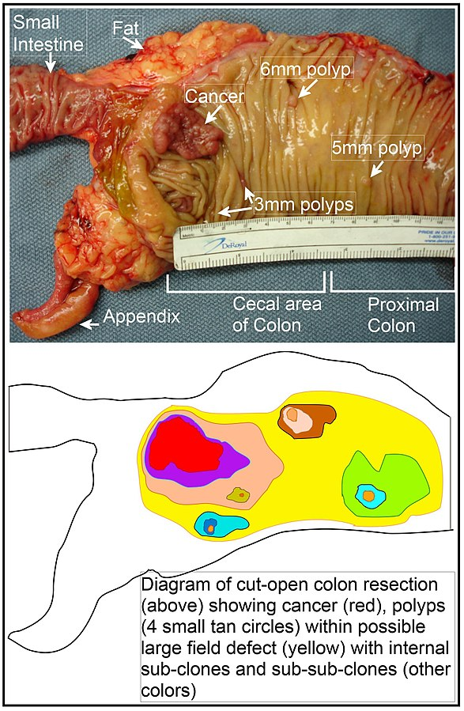
11.4 Multi-step tumor progression helps to explain familial polyposis (家族性息肉病) and field cancerization
Organs affected by sporadic（偶尔发生的） tumors occasionally sprout multiple, apparently independently arising tumors—the phenomenon that is called field cancerization（区域性癌变）.
field cancerization
Notes:
field cancerization的原因是什么？

Slide 20
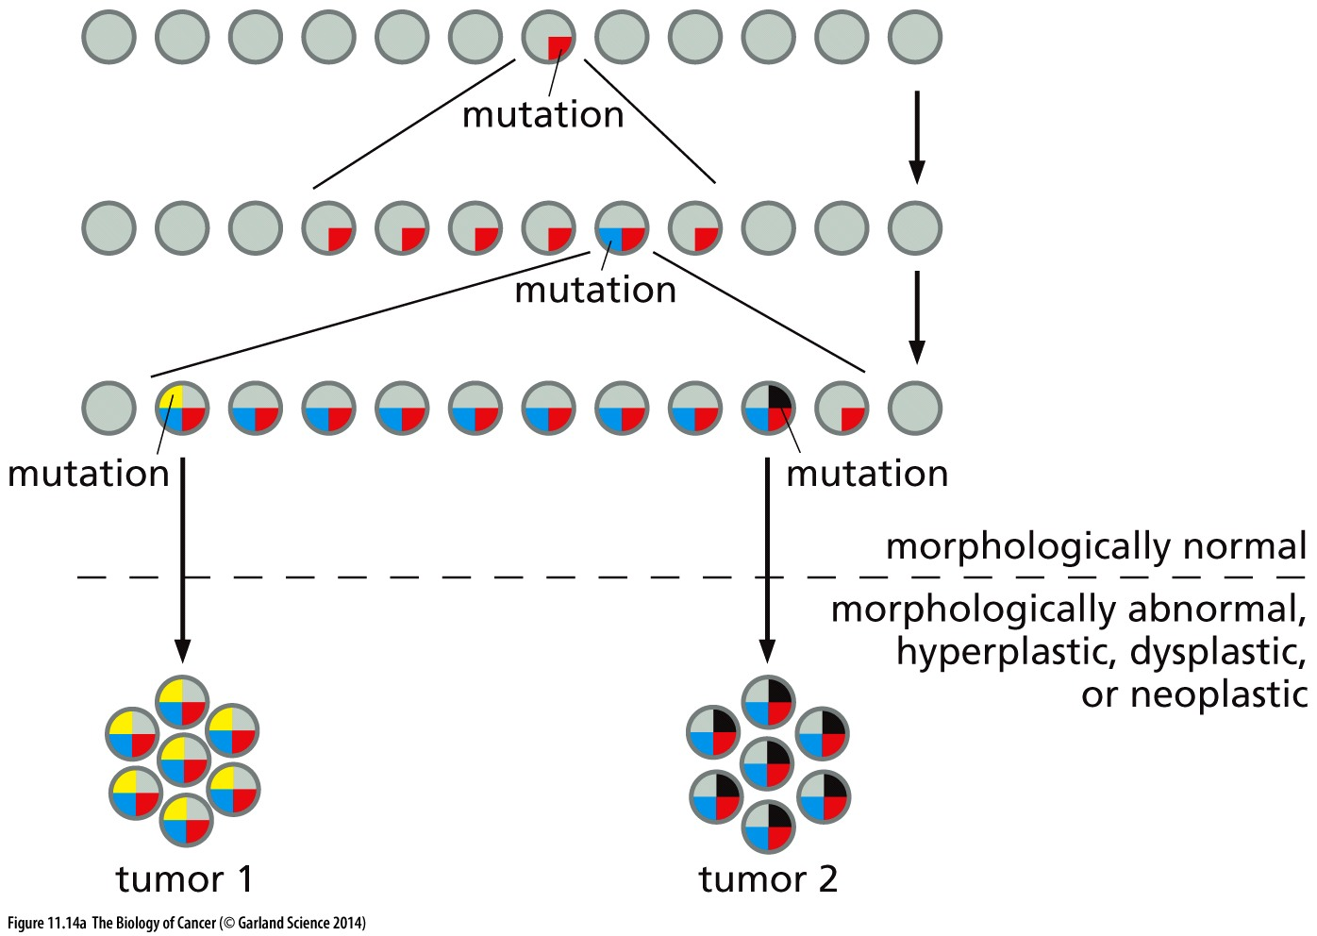
Figure 11.14 Field cancerization
(A) A large area of histologically normal but genetically altered epithelium can sprout multiple, apparently independent foci of neoplastic cells, all of which carry the mutation(s) common to this area as well as subsequently acquired mutants that are unique to each focus. These two tumors will appear to have arisen independently even though they derive from the same clone of initiated cells.
Notes:
一些看起来似乎独立的肿瘤克隆实际上起源于一个早期的肿瘤变异前体细胞

Slide 21
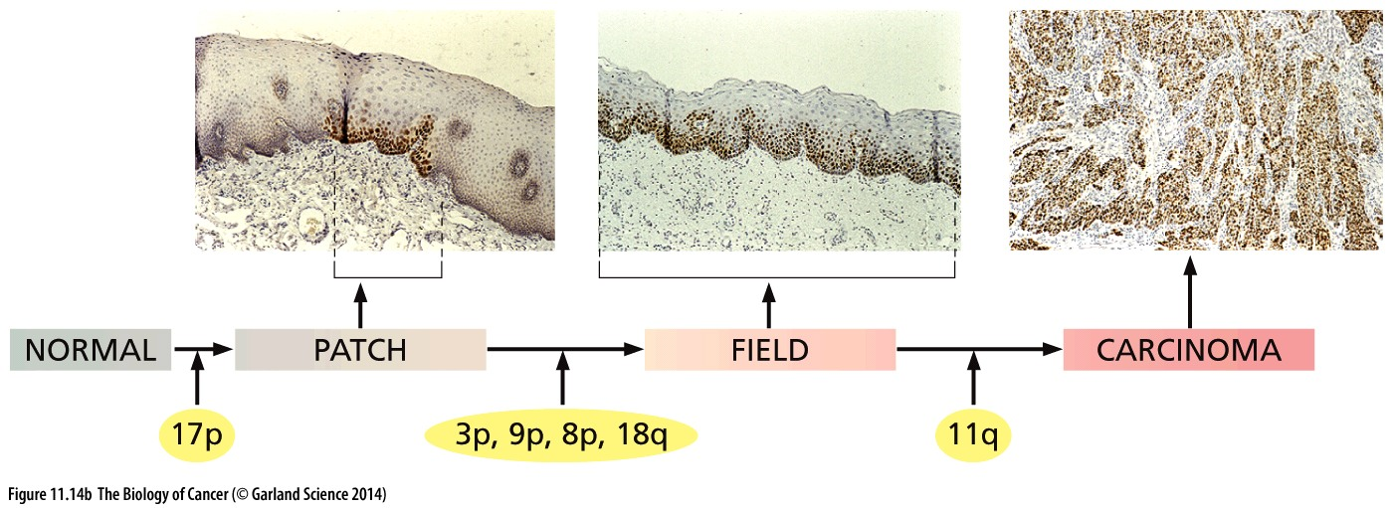
Figure 11.14 Field cancerization
p53-positive (i.e., p53-mutant) cells, detected by immunostaining, are initially found in small, histologically normal patches of the oral epithelium early in the progression of squamous cell carcinomas. As tumor progression proceeds, large fields of p53-mutant cells can be found that remain quite normal histologically, although they have often undergone loss of heterozygosity (LOH) of markers on the indicated chromosomal arms (middle). Eventually, after additional genetic changes, including LOH of the long arm of Chromosome 11, several of the cells in a field may progress independently to squamous cell carcinomas.
Notes:
Why p53 mutant cell is equal to p53 positive cell?

Slide 22
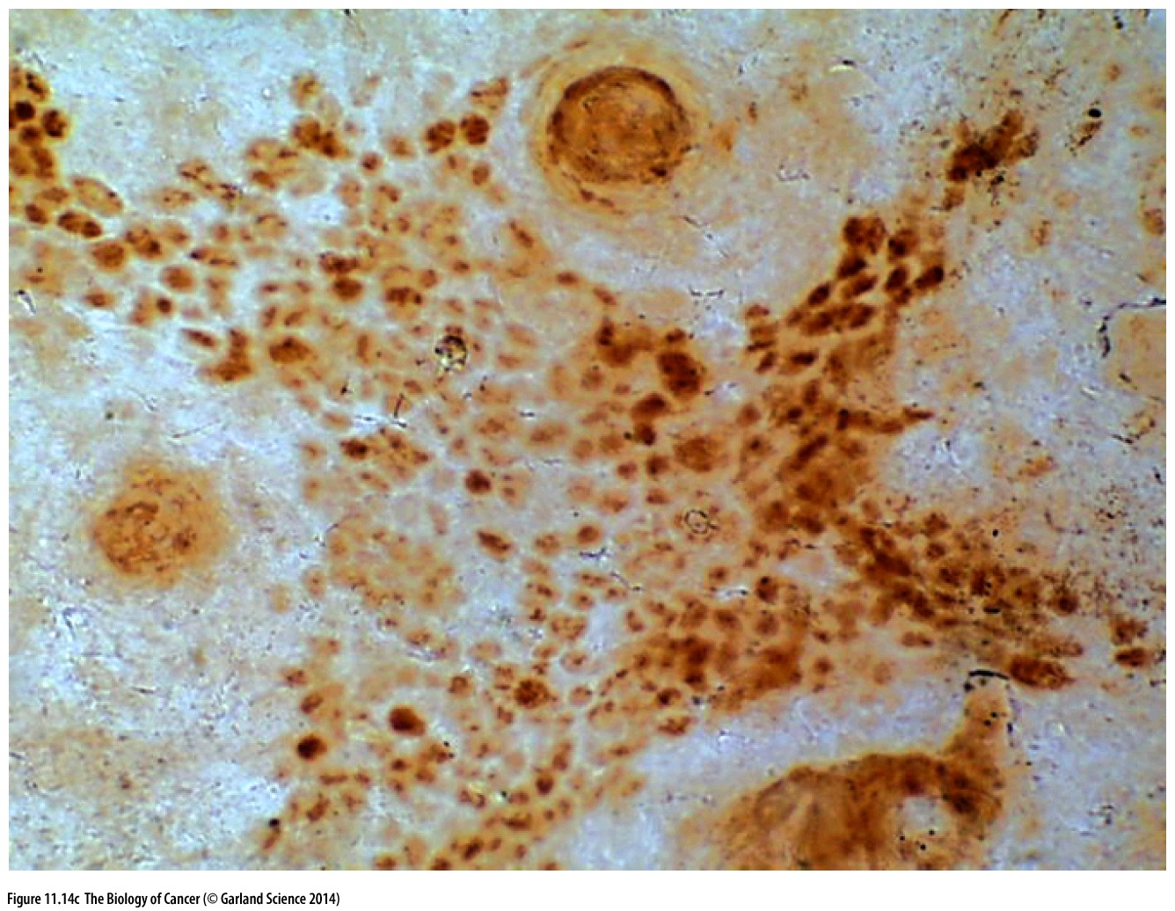
Figure 11.14 Field cancerization
(C) Histologically normal patches of p53-mutant keratinocytes, detected here by immunostaining, can be found in sun-exposed human skin and may contain as many as 3000 cells. Such patches appear to represent fertile ground for the inception of basal cell carcinomas.
Notes:
Why p53 mutant cell is equal to p53 positive cell?

Slide 23
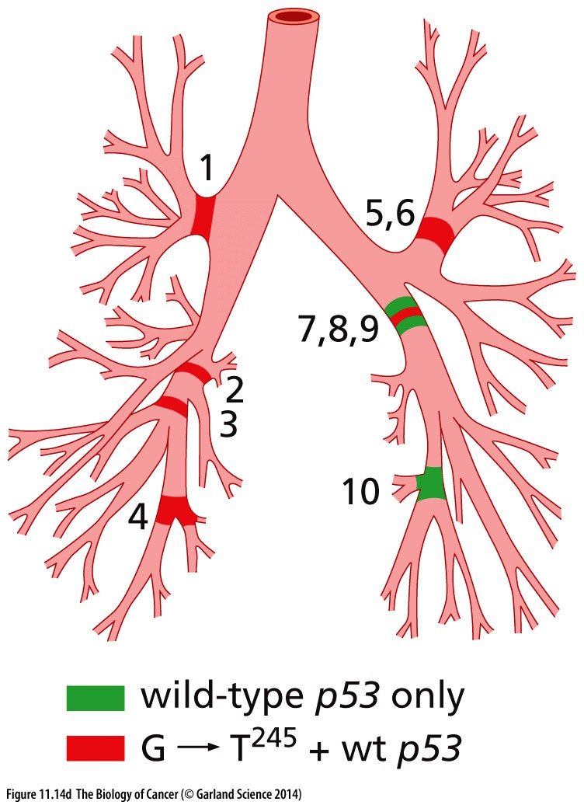
Figure 11.14 Field cancerization
(D) An extreme case of field cancerization can be seen here in lungs of a patient examined upon autopsy. Cells within widely scattered areas in both lobes of the lungs were found to share the same rare p53 somatic mutation, indicating their common genetic origin. While these areas did indeed exhibit mild squamous metaplasia, no carcinomas could be detected; hence, none of these widely dispersed fields had spawned a carcinoma by the time of the patient’s death.

Slide 24
11.5 Cancer development seems to follow the rules of Darwinian evolution
Notes:
肿瘤异质性（Tumor heterogeneity）是目前肿瘤治疗的重大障碍，因而肿瘤的克隆演化是目前肿瘤研究的热点。这主要依赖，单细胞分离，二/三代测序技术的广泛应用。

Slide 25
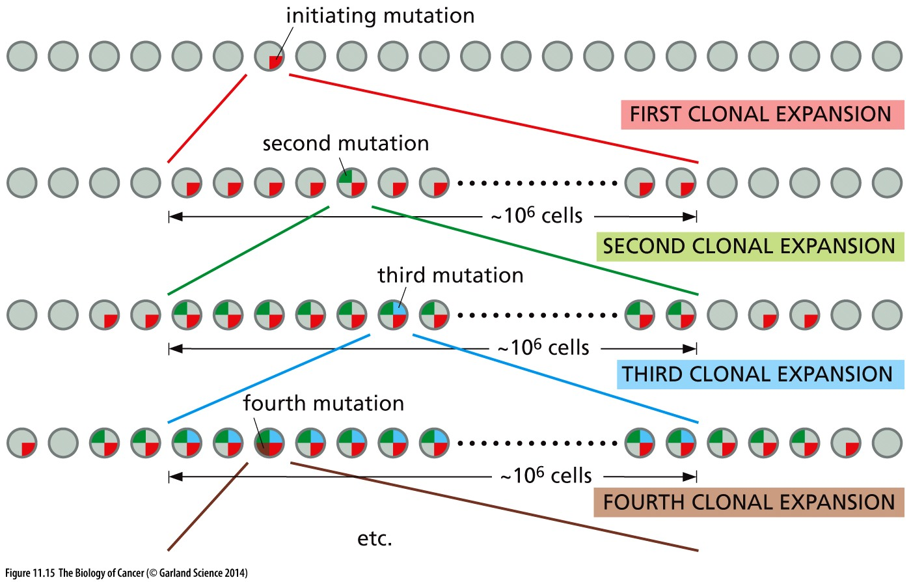
Figure 11.15 Darwinian evolution and clonal successions
Notes:
简单的理论模型，实际肿瘤中往往不是这么简单

Slide 26
11.6 Tumor stem cells further complicate the Darwinian model of clonal succession and tumor progression
Genetic alterations →
Epigenetic alterations… stem cell features →
Cancer formation
Notes:
组织干细胞是目前组织器官修复再生研究的热点，肿瘤干细胞是目前肿瘤研究的一个热点，其中许多关键科学问题尚未解决

Slide 27
History and current status of cancer stem cell research
Cancer stem cells were first identified by John Dick in acute myeloid leukemia in the late 1990s.
Bonnet D, Dick JE (July 1997). "Human acute myeloid leukemia is organized as a hierarchy that originates from a primitive hematopoietic cell". Nature Medicine. 3 (7): 730–7.
Cancer stem cell Vs Cancer initiation cell
Questions for the cancer stem cell field:
1, marker and identity of cancer stem cell;
2, the origin of cancer stem cell;
3, connections between cancer stem cell and normal tissue stem cell;
4, targeting therapy for cancer stem cell;
Notes:
早些时候大家以为，特定癌症内部所有的癌症细胞都是一样的，John Dick 首次实验证明癌症内部的癌症细胞在免疫缺陷鼠中成癌本领有非常大的差别，据此提出 cancer stem cell理论。

Slide 28
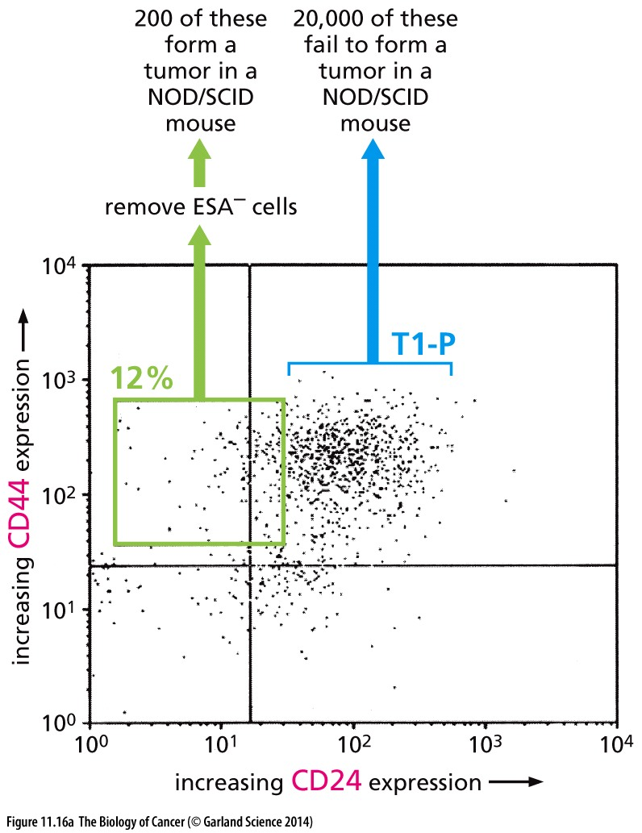
Figure 11.16 Enrichment of breast cancer stem cells
However, certain experiments have cast serious doubt on the notion that all of the cells within a pre-neoplastic (or neoplastic) cell clone are biologically equivalent and therefore equally capable of becoming ancestors of a new successor clone of cells

Slide 29
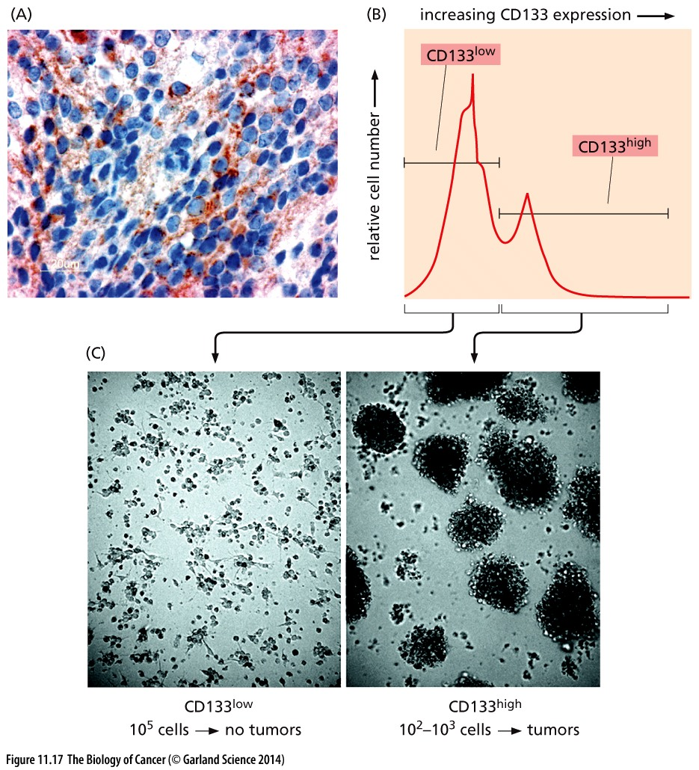
Figure 11.17 Enrichment of brain tumor stem cells
Brain tumor stem cells can be detected because of their expression of CD133, a neural cell surface stem cell antigen.

Slide 30
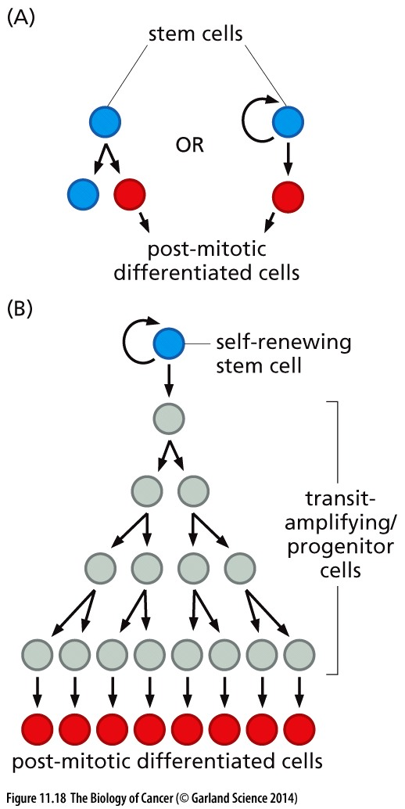
Figure 11.18 Stem cells and their progeny
Tissue stem cell organization models:
A, simple model, asymmetric cell division of a stem cell;
B, complex model, involving transit-amplifying progenitors;
Notes:
常规干细胞的特征：对称分裂 and 不对称分裂

Slide 31
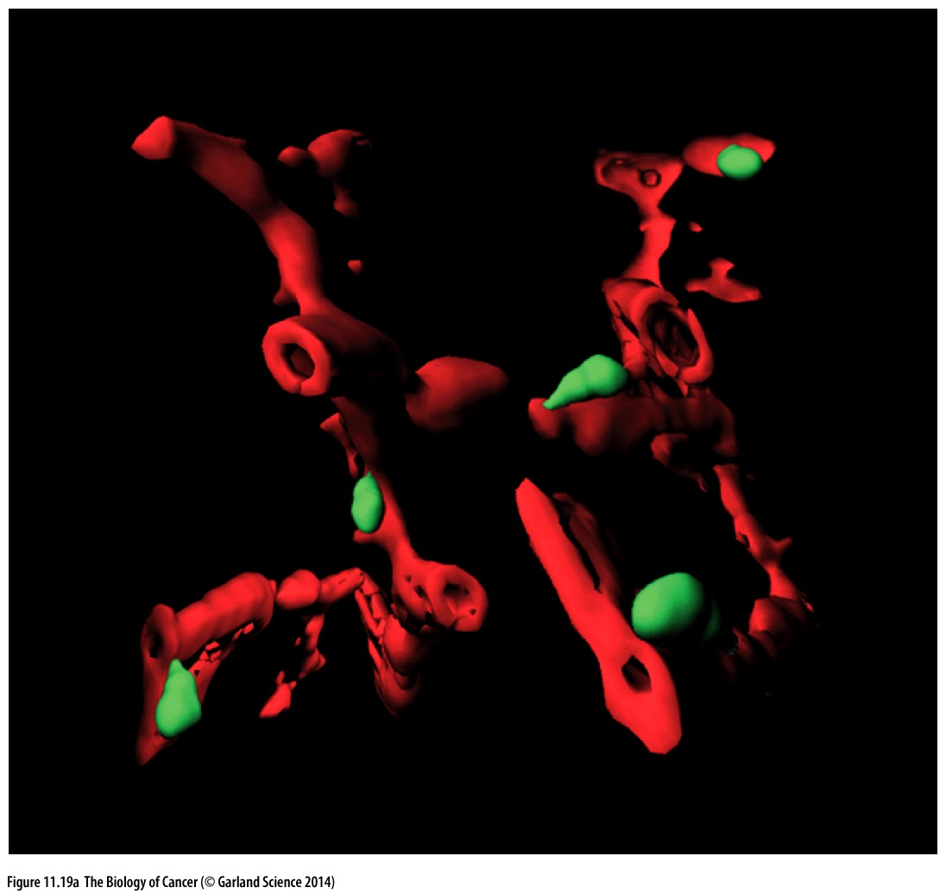
Figure 11.19 Localization of cancer stem cells within tumors
(A) In human gliomas, cancer cells that express nestin, a marker of normal neural stem cells (green), exhibit tumor-initiating ability when implanted in host mice and are therefore termed cancer stem cells (CSCs). These nestin-positive cells are frequently localized near capillaries within these tumors; the microvessels express CD34, an endothelial cell marker (red).
Nestin: glioma stem cell marker
CD34: endothelial cell marker

Slide 32
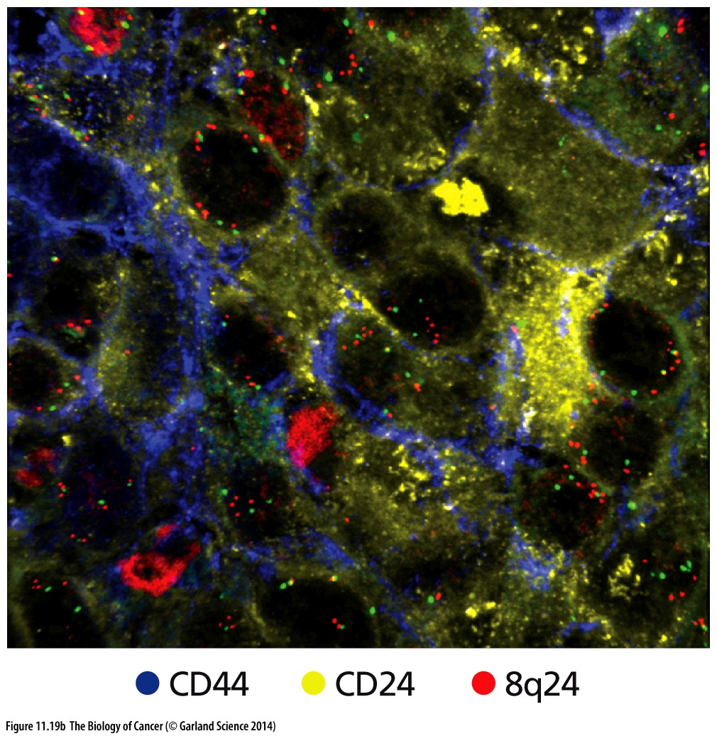
Figure 11.19 Localization of cancer stem cells within tumors
(B) In a lung metastasis of a human breast cancer, the CD44-high cells (blue), which are enriched in cancer stem cells (CSCs), are located in different subdomains from the CD24-high cells (yellow) that generally have low proportions of CSCs.
CD44: Breast cancer stem cell marker

Slide 33
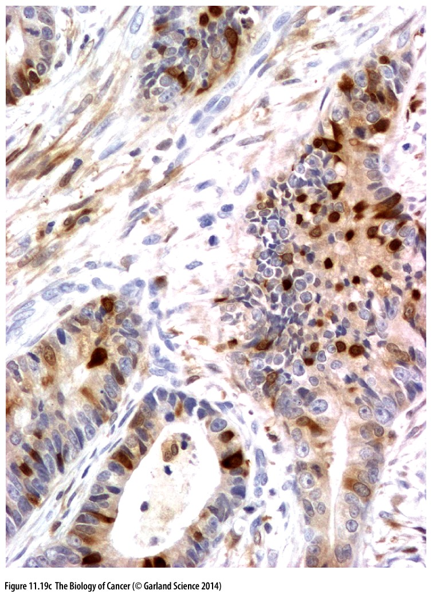
Figure 11.19 Localization of cancer stem cells within tumors
(C) Aldehyde dehydrogenase isoform 1 (ALDH1) has been found to be a useful marker for identifying a variety of normal and neoplastic stem cells. Here, an anti- ALDH1 antibody has been used to localize cells in a primary colon carcinoma that express high levels of this stem cell marker (dark brown).

Slide 34
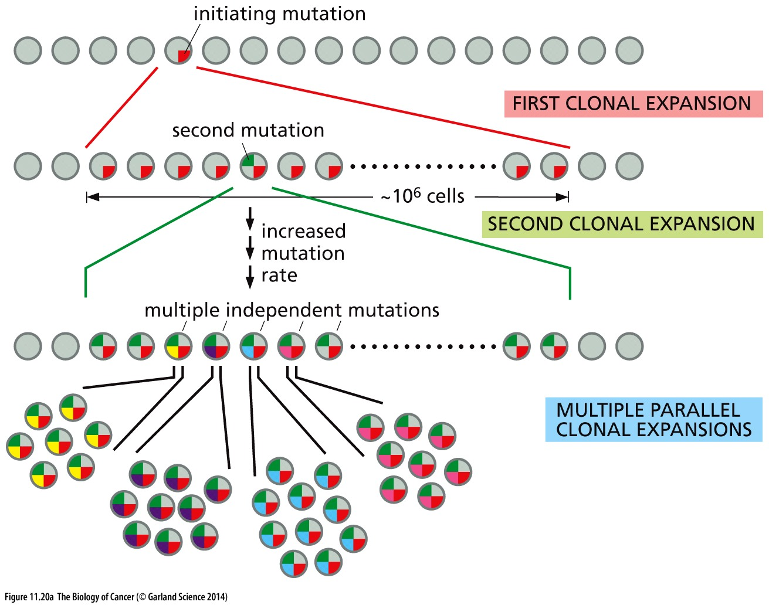
Figure 11.20 Clonal diversification due to high mutation rates
(A) As tumor progression proceeds, the genomes of tumor cells often become increasingly unstable. Consequently, the tumor mass develops an increasing number of distinct sectors, each dominated by a genetically distinct subclone. In this diagram, the involvement of transit-amplifying and cancer stem cells in these processes is not indicated.

Slide 35
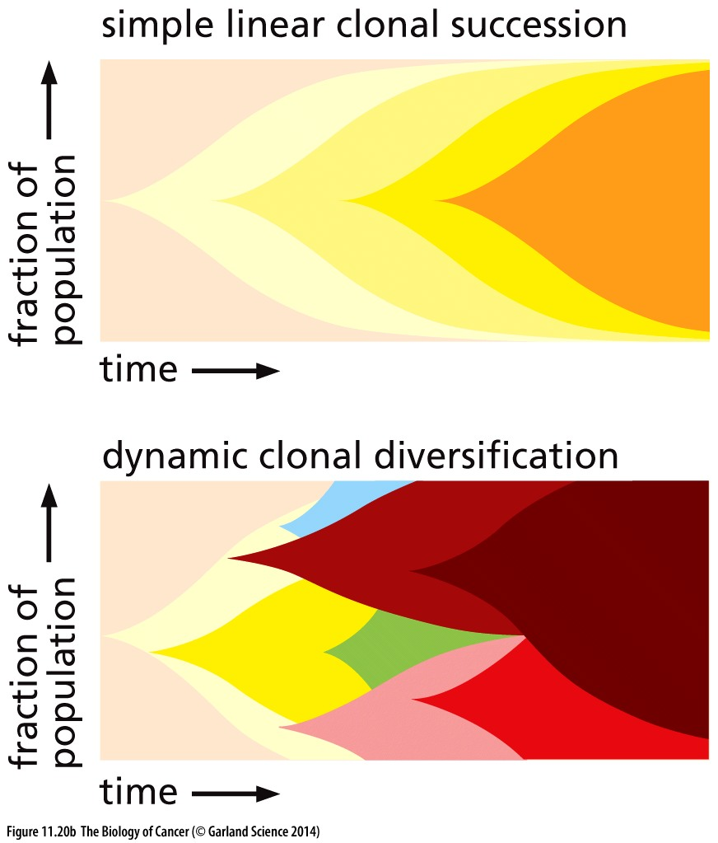
Figure 11.20 Clonal diversification due to high mutation rates
(B) Recent surveys of both genetic and epigenetic (CpG methylation) heterogeneity within individual tumors have provided experimental support for the extensive diversification of distinct clonal populations within a tumor. Thus, the simple linear model of clonal succession (above) should be replaced, at least in late stage tumors, by the dynamic changes depicted below.

Slide 36
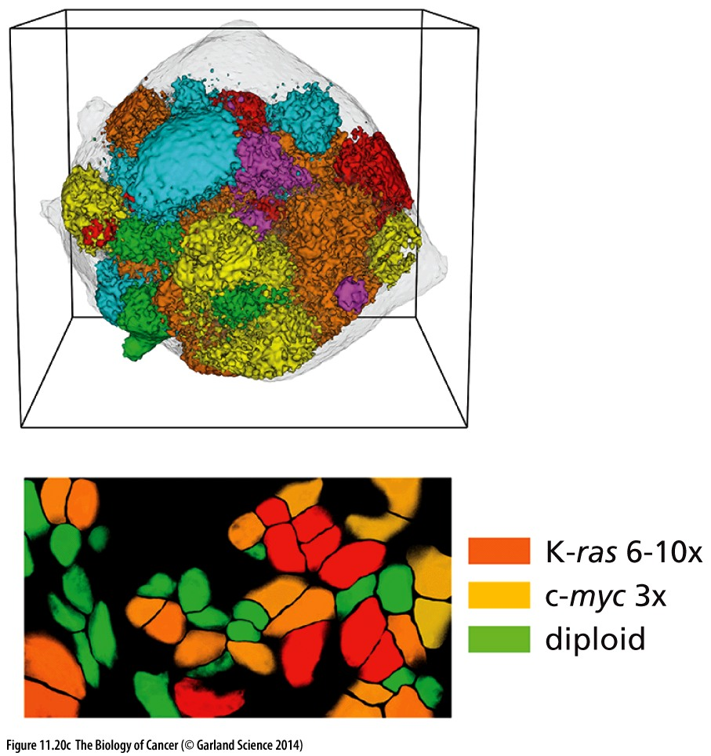
Figure 11.20 Clonal diversification due to high mutation rates
A computationally based model of how a tumor should develop, which assumes the involvement of cancer stem cells (above), predicts discrete sectors in which genetically (and epigenetically) distinct, individual subclones are localized in a tumor composed of 2 million cells. In contrast, use of fluorescence in situ hybridization (FISH) in a section of an actual tumor (below), such as the human breast cancer analyzed here, reveals the extensive physical intermingling of the individual cells deriving, in this case, from three major, genetically distinct subclones coexisting within this tumor. The three clones involve those with apparent diploid genomes, those with 3 copies of c-myc, and those with 6–10 copies of K-ras and a closely linked gene.
Notes:
肿瘤异质性的数学建模 ，以及实际肿瘤情况。肿瘤异质性许多问题尚未解决，是目前研究热点，具体内容仅供参考

Slide 37
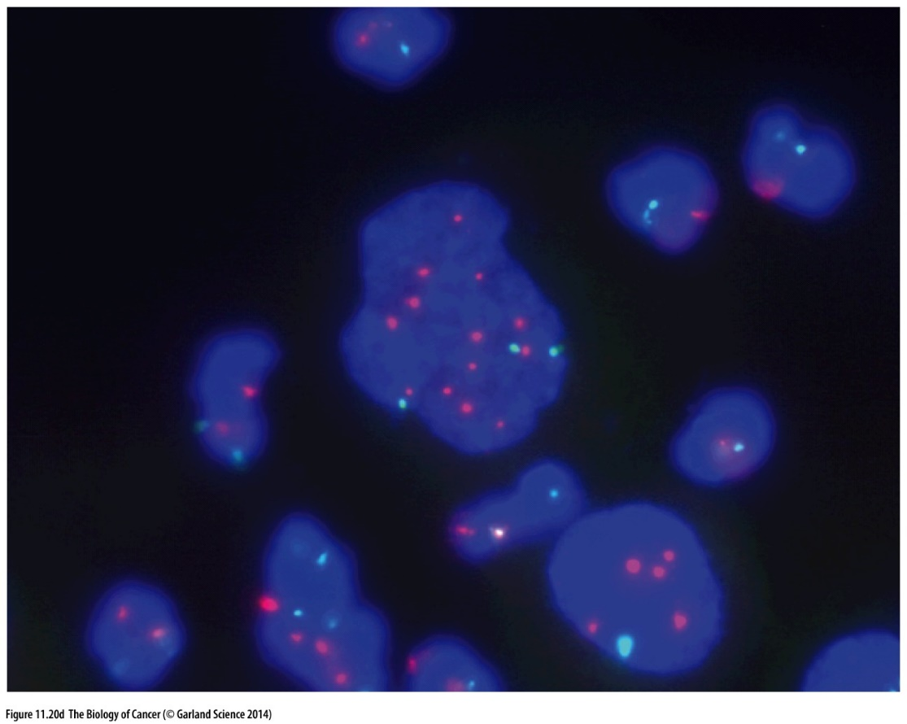
Figure 11.20 Clonal diversification due to high mutation rates
(D) In high-grade tumors, the numbers of chromosomes often fluctuate wildly from one cell to another, indicative of great cell-to cell genetic heterogeneity. In this image, the use of FISH revealed the copy numbers of Chromosomes 11 (green) and 17 (pink) in cells from a pleural effusion in a non-small-cell lung carcinoma patient. In addition to fluctuations in chromosome number, highly polyploidy giant nuclei are apparent.
Notes:
肿瘤异质性非常大，同一个肿瘤内部细胞有很大的genetic 差异，该图就是很好的例证。

Slide 38
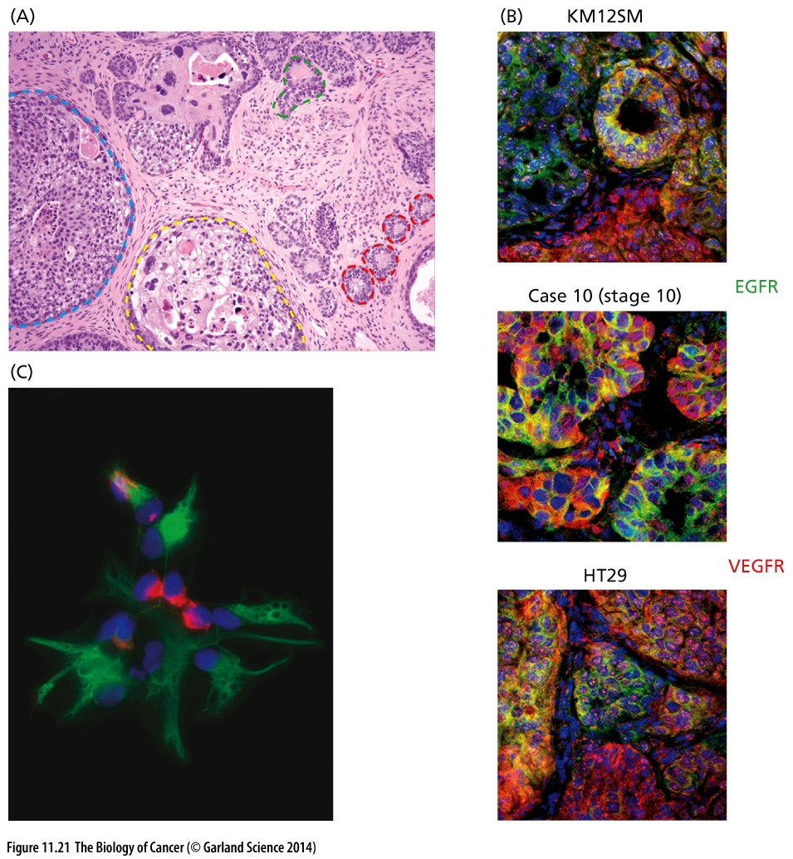
Figure 11.21 Phenotypic diversification within a tumor cell population
Commonly performed surveys of human tumors (Figure 11.21A) suggest a second source of the heterogeneity within tumors, namely, epigenetic plasticity.
Notes:
肿瘤异质性除了genetic差异外，还包括epigenetic 差异。

Slide 39
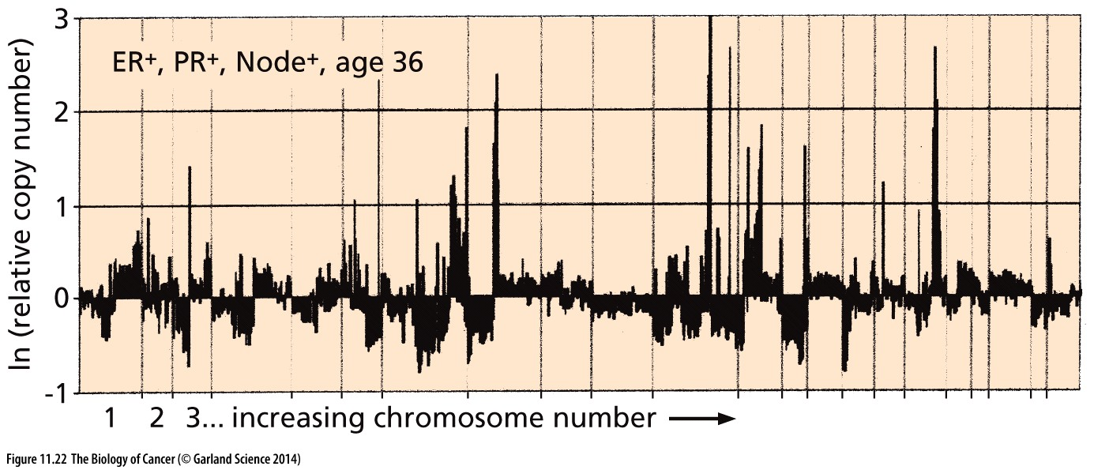
Figure 11.22 CGH analysis of a breast cancer genome
The genomic DNA was analyzed here using comparative genomic hybridization. The degree of amplification or deletion is indicated by excursions from the normal copy number, which is designated as “0” on the ordinate since the data are plotted logarithmically, with amplifications shown above the line and deletions shown below the line. This analysis indicates rampant genomic instability and resulting genetic diversification of subclones of cancer cells within this tumor.
Notes:
拷贝数变异，另一类cancer genetic alteration

Slide 40
CGH and SNP array
For detecting gene copy number
Comparative genomic hybridization is a molecular cytogenetic method for analysing copy number variations (CNVs) relative to ploidy level in the DNA of a test sample compared to a reference sample, without the need for culturing cells.
Original CGH and array CGH (aCGH) are both older techniques compared to SNP array in regards to CNV analysis
SNP array is a type of DNA microarray which is used to detect polymorphisms (esp, copy number variations (CNVs) ) within a population.
Methods evolution for gene copy number detection
Cytogenetics
CGH
SNP array

Slide 41
11.9 Multiple lines of evidence reveal that normal cells are resistant to transformation by a single mutated gene
11.10 Transformation usually requires collaboration between two or more mutant genes
Notes:
Single Oncogene activation always leads to cell apoptosis or senescence

Slide 42
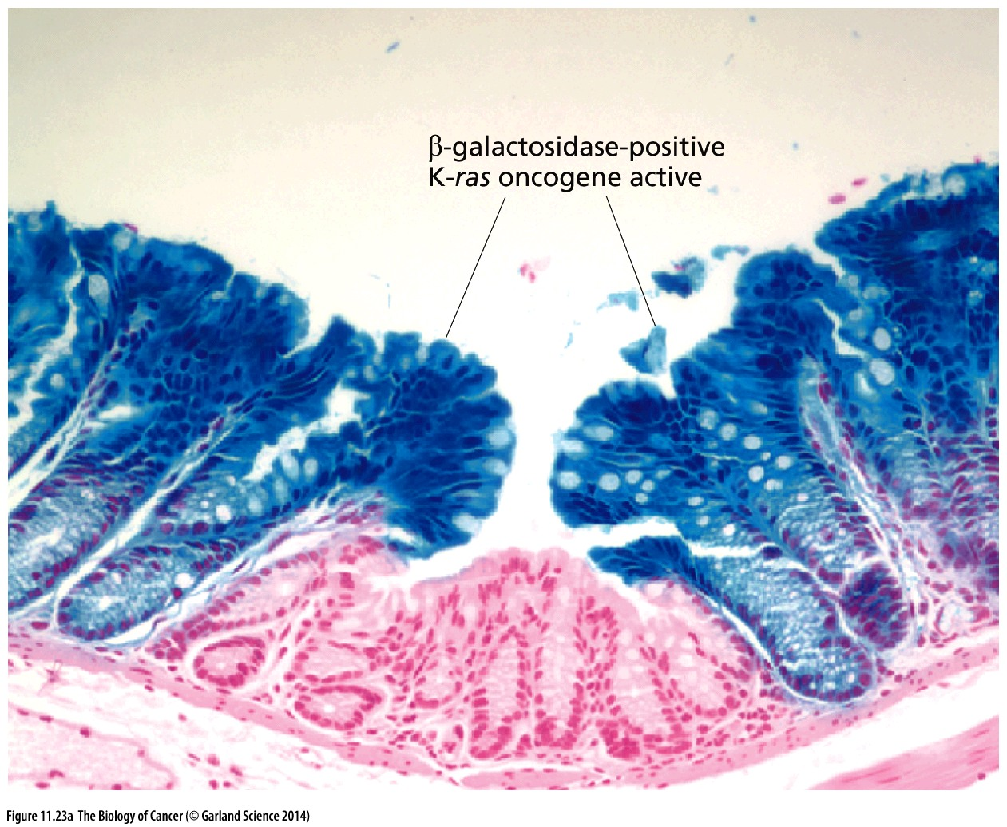
Figure 11.23 One or two oncogenic lesions do not suffice to generate full-blown tumors
As indicated here, colonic epithelial cells in which both β-galactosidase (blue) and the K-ras oncogene (not visible) have become expressed create localized regions of hyperplasia in which the epithelial cells are otherwise normal, indicating that the ras oncogene on its own does not suffice to transform these cells into a tumorigenic state.

Slide 43
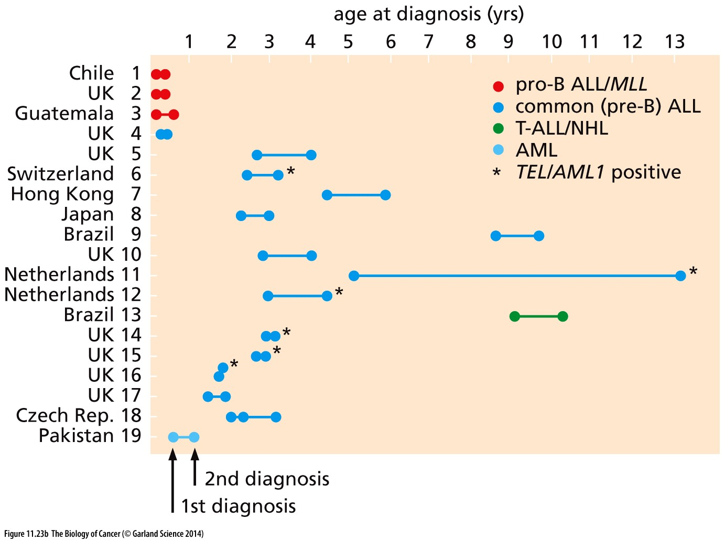
Figure 11.23 One or two oncogenic lesions do not suffice to generate full-blown tumors
(B) Identical twin pairs have been documented throughout the world in which both twins develop the same type of leukemia. The leukemias invariably share a common chromosomal marker or mutation, indicating that they derive from the same clone of initiated cells. The fact that many of these leukemias are diagnosed at quite different postnatal ages (dots) indicates that these initiating somatic mutations, which occurred in utero, were not, on their own, sufficient to trigger the formation of a clinically apparent leukemia.
Notes:
胚胎期，双胞胎共用血液循环

Slide 44
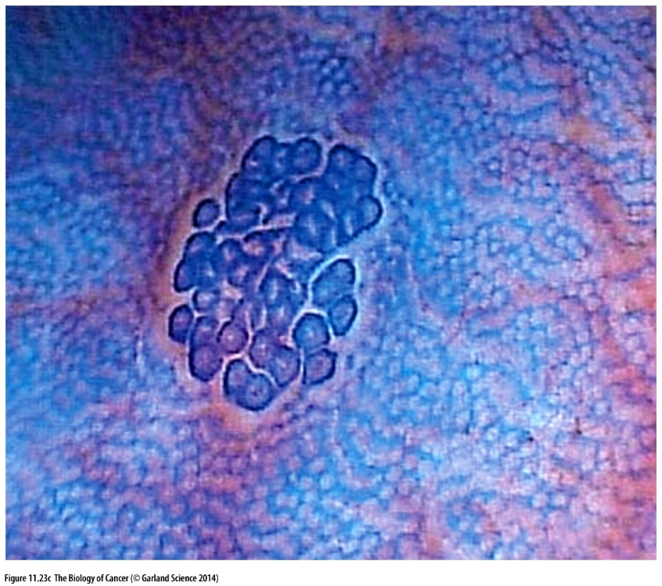
Figure 11.23 One or two oncogenic lesions do not suffice to generate full-blown tumors
(C) A cluster of aberrant crypt foci (ACFs) in the human colon are clearly revealed by colonoscopy. ACFs like this one frequently carry an inactivated APC tumor suppressor gene together with an activated K-ras oncogene; they may progress into adenomatous polyps, which themselves are still not full-fledged colon carcinomas. Hence, even two oncogenic genetic lesions, acting together, generate human cells that are still several steps short of being fully transformed.

Slide 45
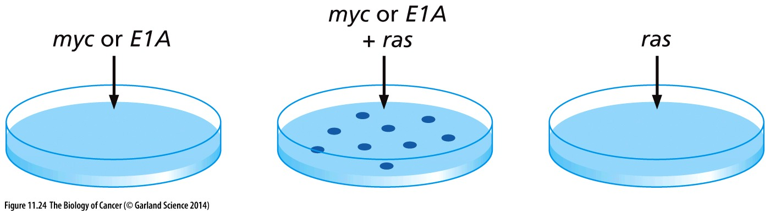
Figure 11.24 Oncogene collaboration in rodent cells in vitro
Cultures of early-passage rat embryo fibroblasts or baby hamster kidney cells were exposed to cloned DNAs via the calcium phosphate gene transfection procedure.
E1A inhibit Rb

Slide 46
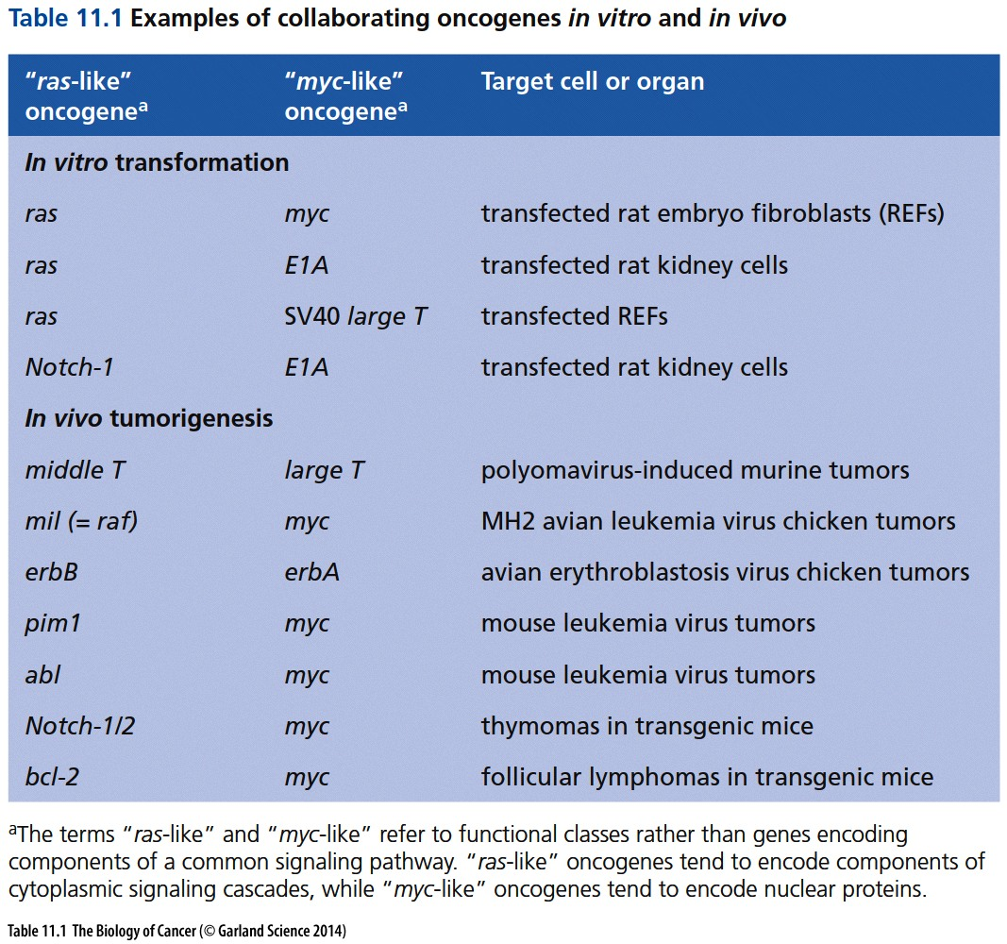

Slide 47
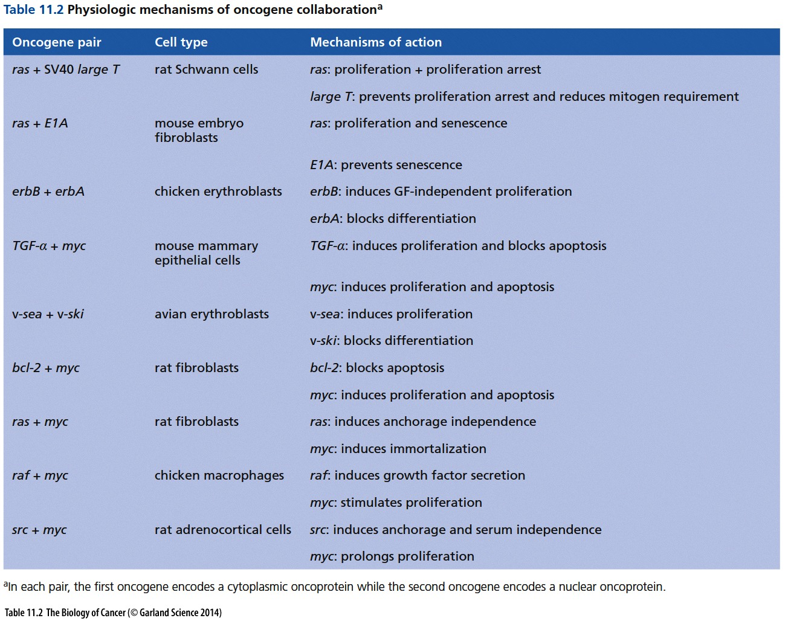

Slide 48
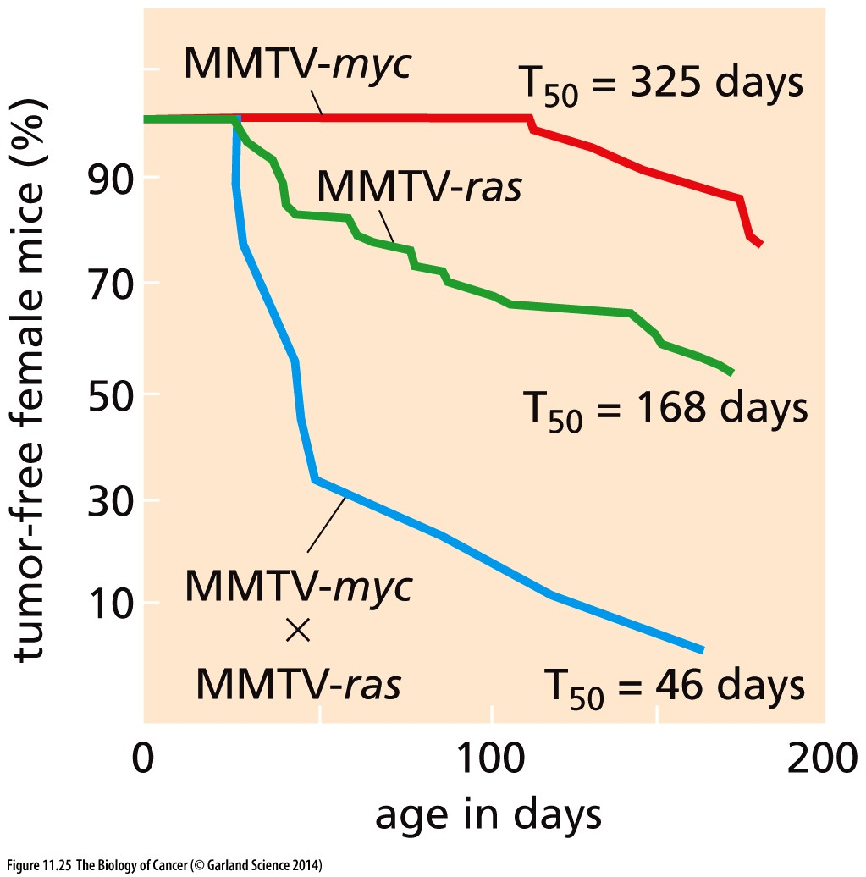
Figure 11.25 Oncogene collaboration in transgenic, cancer-prone mice
Mouse model breast cancer

Slide 49
11.12 Human cells are constructed to be highly resistant to immortalization and transformation
It is easy to immortalize rodent cells simply by propagating them through a relatively small number of passages in vitro, such as the NIH 3T3 cells discussed earlier. In contrast, human cells rarely, if ever, become immortalized following extended serial passaging in culture.
Notes:
一个原因是：鼠的telomere 比人的长

Slide 50
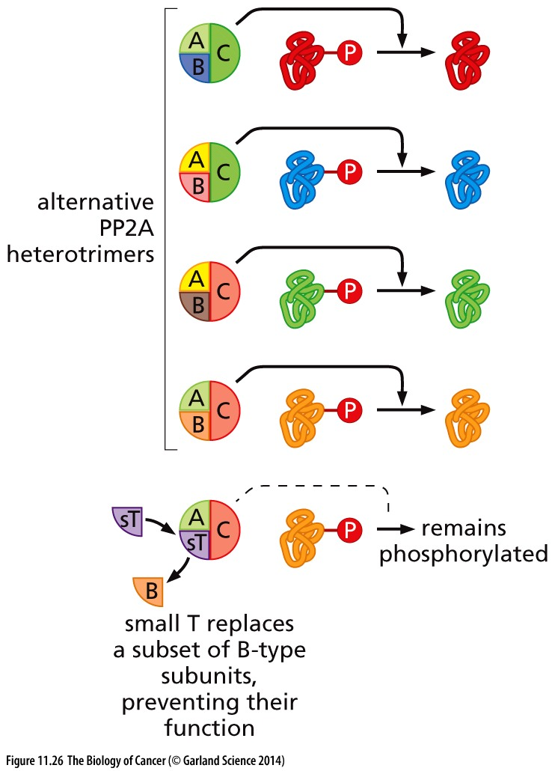
Figure 11.26 Protein phosphatase 2A
The various PP2A holoenzymes are responsible for dephosphorylating cellular phosphoproteins bearing either phosphoserine or phosphothreonine residues. The small T (sT) oncoprotein of SV40 can associate with the A and C subunits and thereby prevent the association of certain B-type subunits with A + C. In so doing, sT prevents PP2A from dephosphorylating a subset of its normal constituency of substrates. This contributes in some still-poorly understood fashion to the experimental transformation of human cells.
Notes:
仅供参考

Slide 51
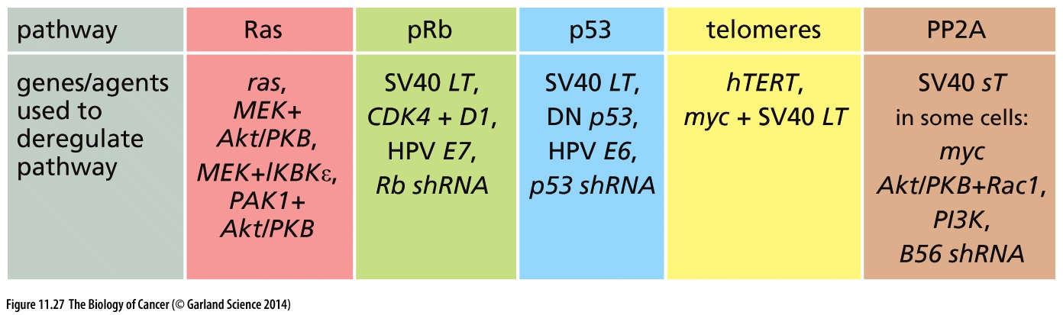
Figure 11.27 Intracellular pathways involved in human cell transformation
These changes involve:
(1)the mitogenic signaling pathway controlled by Ras (see Chapter 6);
(2) the cell cycle checkpoint controlled by pRb (see Chapter 8);
(3) the alarm pathway controlled by p53 (see Chapter 9);
(4) the telomere maintenance pathway controlled by hTERT (see Chapter 10); and
(5) the signaling pathways controlled by protein phosphatase 2A; the latter include effects modulating the activity of the mTOR, Myc, β-catenin, and PKB/Akt signaling proteins.
Notes:
不同组织细胞需要不同信号通路来永生化；本书提到的五种信号通路具有一定代表性，当然不能代表所有类型肿瘤，也不是唯一或必需的永生化条件。

Slide 52
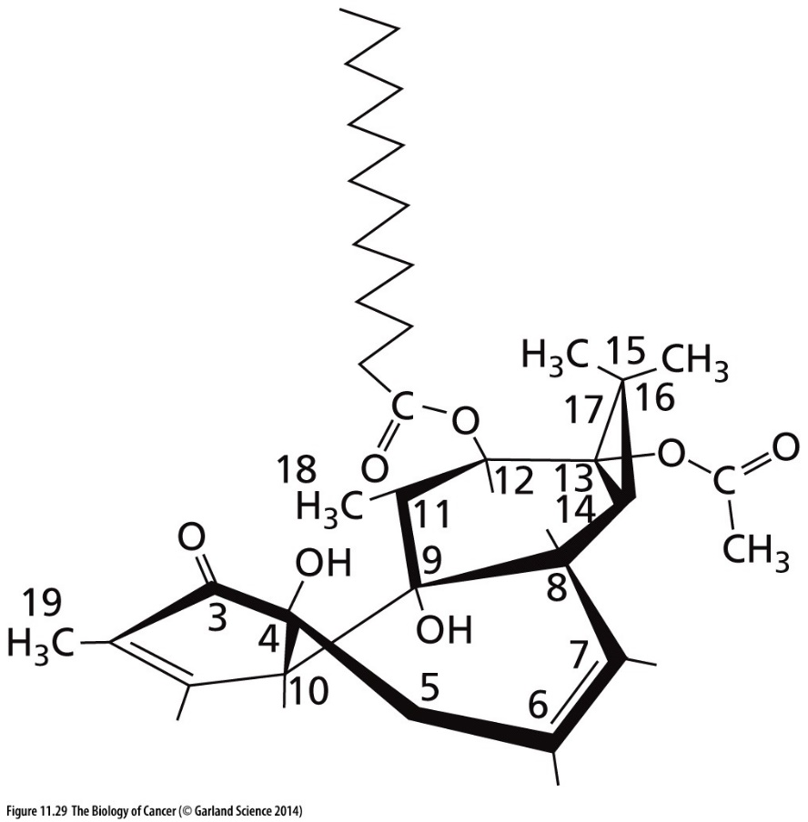
11.13 Nonmutagenic agents, including those favoring cell proliferation, make important contributions to tumorigenesis
Figure 11.29 TPA, an important promoter of skin tumorigenesis
The stereochemical(立体化学) structure of 12-O-tetradecanoylphorbol-13-acetate (TPA), also known as phorbol-12- myristate-13-acetate (PMA,佛波酯), is shown here. TPA is extracted from the seeds of the croton(巴豆) plant. Its main target in cells is protein kinase C-α (PKC-α), which it activates.

Slide 53
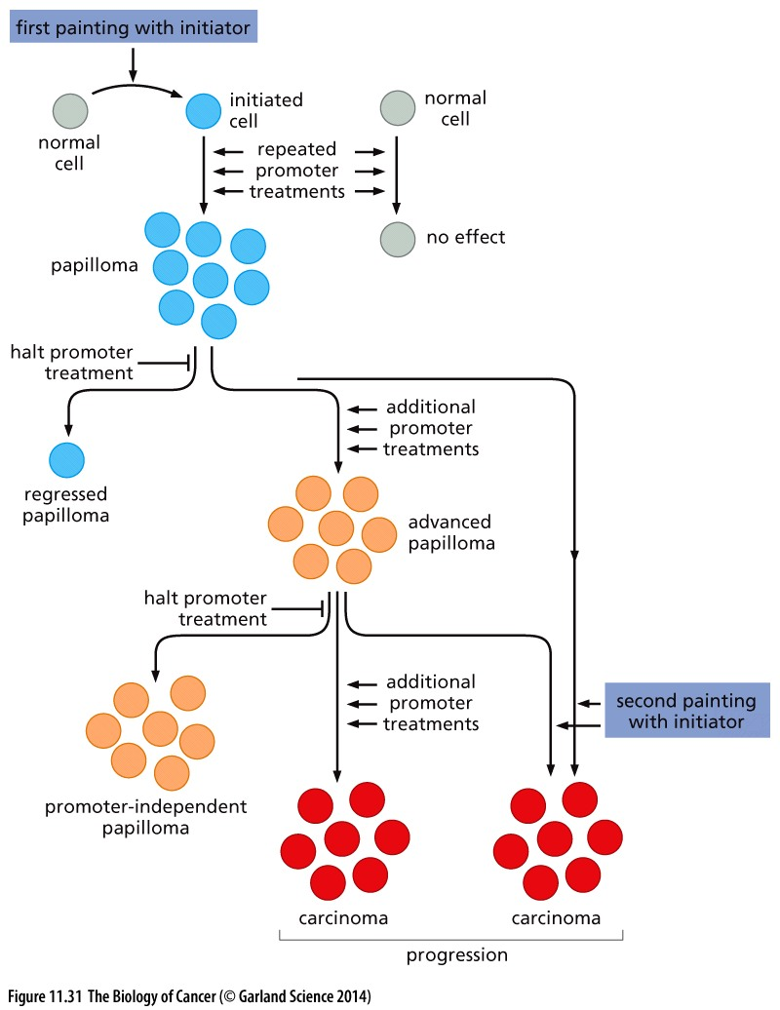
Figure 11.31 Scheme of initiation and promotion of epidermal carcinomas in mice
Initiator: mutagenic agents;
Promoter: non-mutagenic tumor promoting agents, like TPA;
Tumor initiator
Genetic alteration
Normal cell
Tissue microenvironment
Tumor promoter
Cancer cell
Epigenetic alteration
Tumor promoter
Notes:
上世纪四五十年代的试验

Slide 54
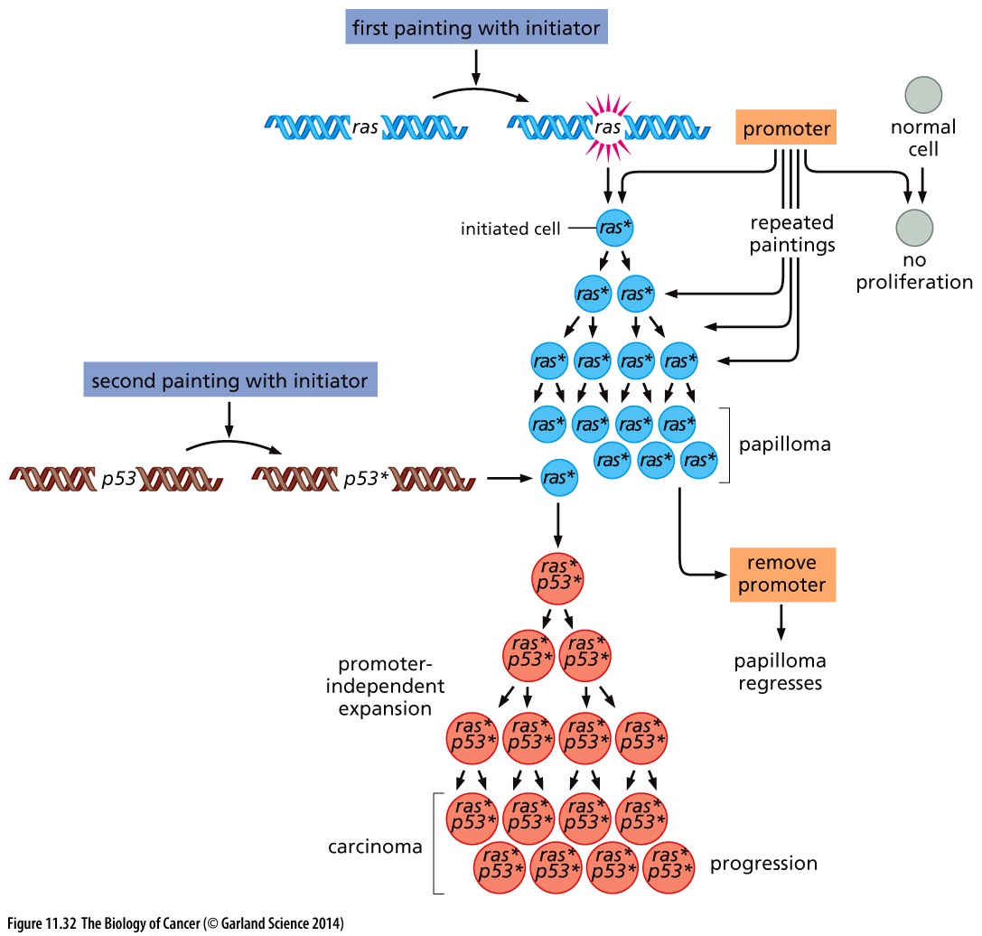
Figure 11.32 Genes and proteins involved in mouse skin carcinogenesis
Notes:
几十年后，总结前一张ppt的分子机制

Slide 55
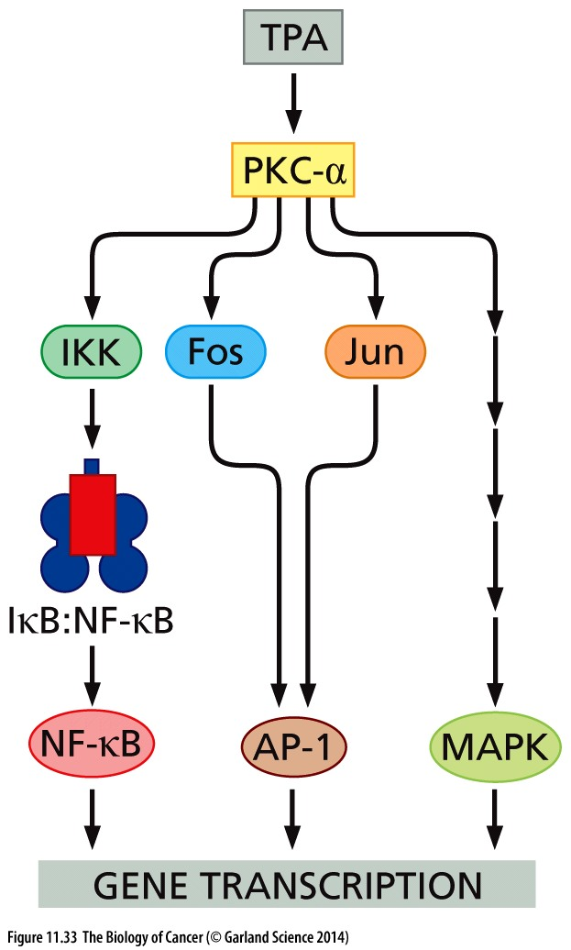
11.14 Toxic and mitogenic agents can act as human tumor promoters
Figure 11.33 Activation of Fos, Jun,
and NF-κB by PKC-α
Notes:
TPA是一个常用的tumor promoter

Slide 56
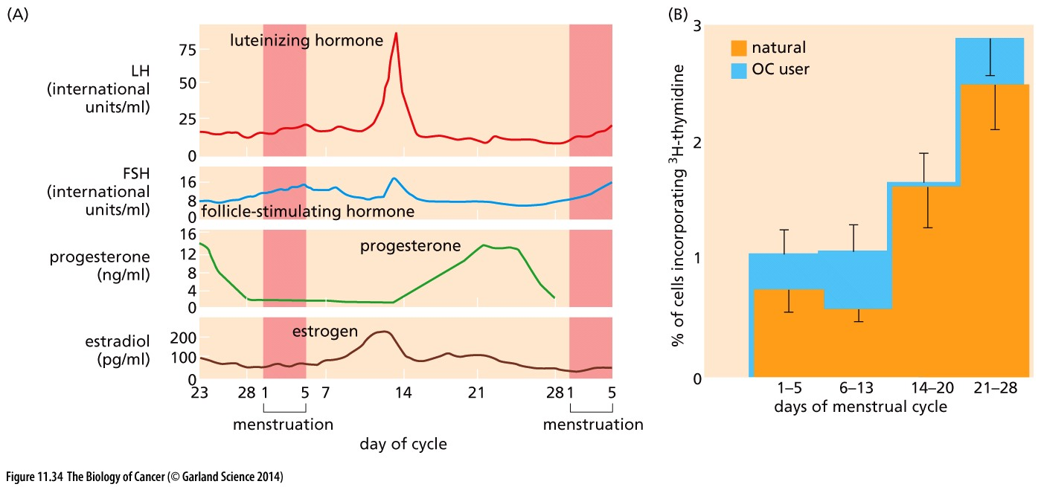
Figure 11.34 Fluctuations of hormone levels, cell proliferation, and mammary gland morphology during the menstrual cycle
The effects of estrogen on breast cancer are surely complex. Still, it is evident that estrogen, and perhaps other hormones such as progesterone and even prolactin, periodically induce cell proliferation in a way that enables breast cancer progression
Notes:
统计表明：女性月经开始年龄越早，结束年龄越晚，则breast cancer的发病率越高。因为月经伴随着激素的诱导，激素在某些情况下就如同tumor promoter一样，促进细胞增殖。

Slide 57
11.15 Chronic inflammation often serves to promote tumor progression in mice and humans

Slide 58
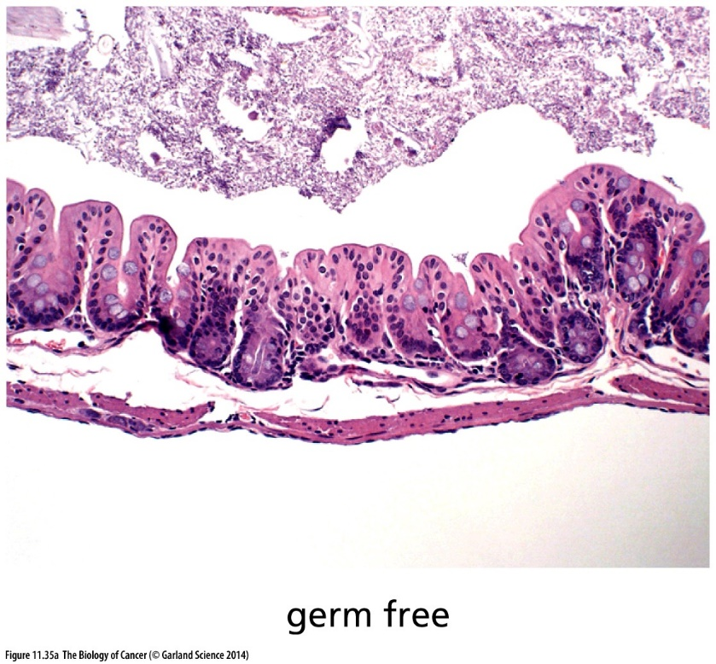
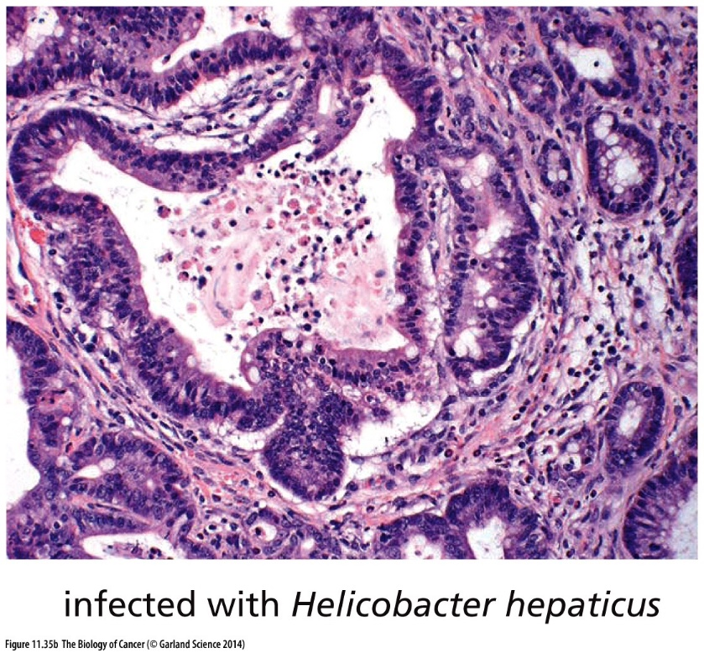
Figure 11.35 Colonic inflammation and tumor promotion
TGF-β1 deficient mouse
The development of tumor in the colon is strongly dependent on chronic inflammation occurring in this organ.

Slide 59
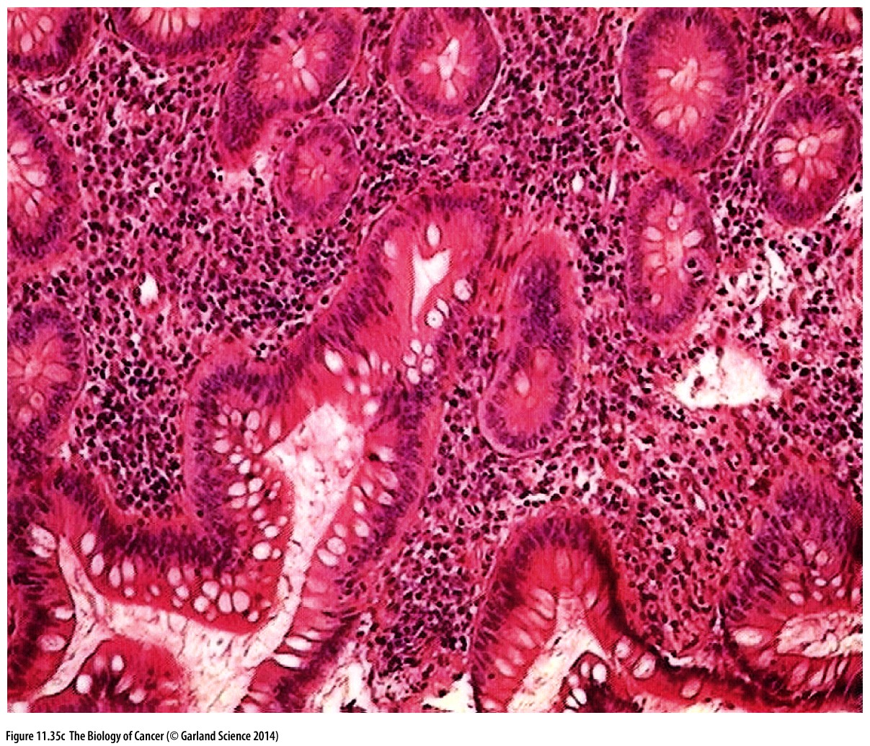
Figure 11.35 Colonic inflammation and tumor promotion
(C) Human ulcerative colitis（溃疡性结肠炎）involves chronic inflammation of regions of the colonic mucosa, which leads after many years to substantially increased risk of colon carcinoma. In this condition, the stromal areas between the colonic crypts are infiltrated with large numbers of lymphocytes, which are associated with inflammation (small dark purple nuclei).

Slide 60
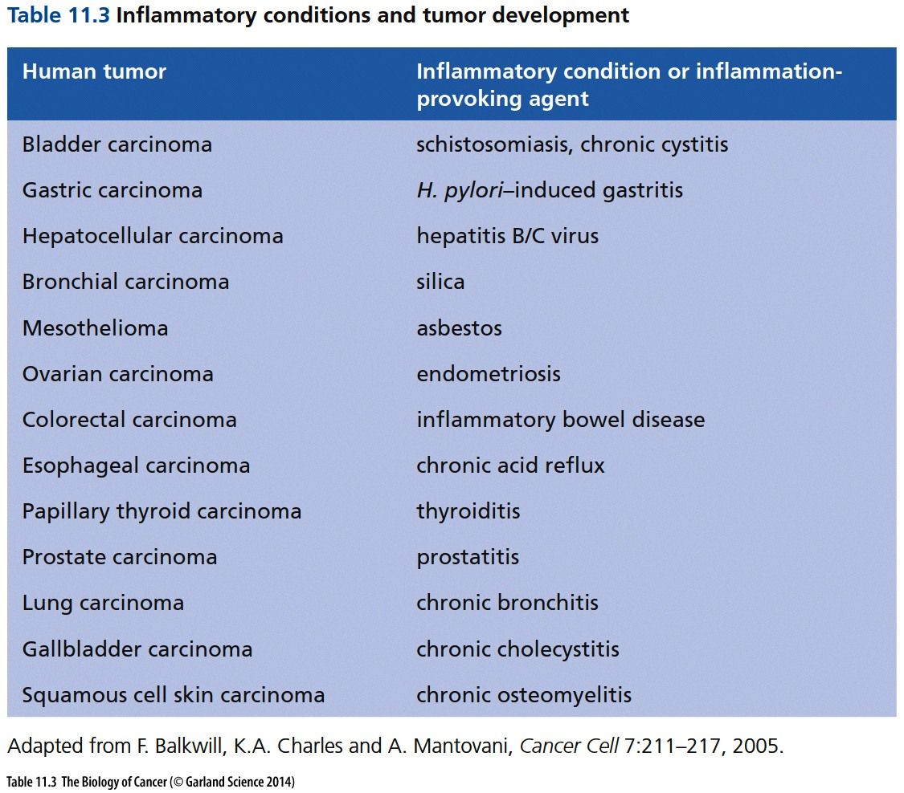
Notes:
胃幽门螺旋杆菌

Slide 61

Figure 11.36 Chronic inflammation leading to cancer
(A) A graphic demonstration of chronic inflammation leading to cancer is provided by carcinomas of the epithelial lining of the gallbladder（胆囊）(white mass, above), which are commonly associated with the formation of gallstones arising as precipitates from the bile (brown masses, below).

Slide 62

Figure 11.36 Chronic inflammation leading to cancer
(B) Chronic hepatitis B virus (HBV) infection creates continual cell death of hepatocytes together with chronic inflammation, as indicated by the numerous lymphocytes (small dense nuclei, left panel). Over a period of decades, this can lead to an almost 100-fold increased risk of liver cancer. The inflammation in the liver of someone suffering from chronic hepatitis C virus (HCV) infection is strikingly similar (right panel). It is suggests that the inflammatory states, rather than some specific aspect of viral function, are responsible for the appearance of HCC in patients infected with either of these viruses.

Slide 63
11.16 Inflammation-dependent tumor promotion operates through defined signaling pathways
a large number of epidemiologic observations that anti-inflammatory drugs, such as aspirin and sulindac, function to reduce the incidence of a variety of carcinomas in humans. For example, one study showed that those who took low doses of a nonsteroidal anti-inflammatory drug (NSAID)—an aspirin tablet once every day or two over a period of 15 years—had a lung cancer rate of 0.68, a breast cancer rate (in women) of 0.70, and, in younger men, a colorectal cancer rate of 0.35 compared with the rates of these cancers in corresponding control groups.

Slide 64

Aspirin (阿司匹林)
Aspirin, also known as acetylsalicylic acid (乙酰水杨酸), is a medication used to treat pain, fever, and inflammation.
Aspirin, in the form of leaves from the willow (柳树) tree, has been used for its health effects for at least 2,400 years. The first study of an extract from the bark for fever was completed in 1763 by Edward Stone. Felix Hoffmann, a chemist at Bayer, has been credited with first chemically making aspirin in 1897. Aspirin is one of the most widely used medications globally with an estimated 40,000 tonnes being consumed each year.
In 1971, British pharmacologist John Robert Vane, then employed by the Royal College of Surgeons in London, showed aspirin suppressed the production of prostaglandins (前列腺素). For this discovery he was awarded the 1982 Nobel Prize in Physiology or Medicine, jointly with Sune Bergström and Bengt Ingemar Samuelsson.
Aspirin irreversibly inhibits COX-1 and COX-2. Aspirin is thought to reduce the overall risk of both getting cancer and dying from cancer. This effect is particularly beneficial for colorectal cancer. It may also slightly reduce the risk of endometrial cancer, breast cancer, and prostate cancer.

Slide 65


Slide 66

Figure 11.38 Chronic liver inflammation acts via NF-κB to induce hepatocellular carcinomas
In this mouse model of liver carcinogenesis, deletion of the mdr (multi-drug resistance) gene causes chronic liver inflammation, which generates dysplastic(异型) foci among the hepatocytes, some of which progress to form hepatocellular carcinomas. (A) An infiltrate of inflammatory cells in the liver of an mdr–/– mouse (outlined, center panel) contrasts with cells in the normal liver (left panel) and the liver of an mdr–/– mouse that has been treated with a potent anti-inflammatory drug,ibuprofen (right panel). Such areas of inflammatory infiltrate appear to be critical to the formation of dysplastic foci and thus to the subsequent formation of hepatic carcinomas.

Slide 67

Figure 11.38 Chronic liver inflammation acts via NF-κB to induce hepatocellular carcinomas
Inflammation
TNF-a
NF-kB
Promote Survival

Slide 68

Figure 11.39 Prostaglandin metabolism and the actions of anti-inflammatory drugs
The profound effects of anti-inflammatory drugs in suppressing the incidence of a variety of commonly occurring carcinomas are due to their ability to inhibit the catalytic activity of the cyclooxygenase-2 (COX-2) enzyme (sometimes called prostaglandin H2 synthase). COX-2 is induced in many tissues in response to inflammatory stimuli. (A) The two distinct catalytic activities of COX-2 result in the conversion of arachidonic acid into prostaglandin H2. The latter is metabolized to prostaglandin E2 (PGE2; red), which evokes many of the tumor-promoting responses described here.

Slide 69


B
C
(B) The catalytic sites of COX-2, a homodimer, are largely inactivated by the most commonly used anti-inflammatory drug—aspirin (acetylsalicylic acid)—which acetylates (yellow balls, arrows) serine 530 of COX-2 and leaves the salicylate moiety weakly bound in the catalytic cleft (orange balls, arrows). (C) In more detail, the acetylation of serine 530 by aspirin obstructs( 阻塞) the enzymatic activity of COX-2 that is responsible for converting arachidonic acid to the precursor of all prostanoids, prostaglandin G2; the latter is converted further to prostaglandin H2 by a second site in the COX-2 enzyme.

Slide 70


Figure 11.43 A model of epithelial inflammation and tumor promotion
Inflammatory stimuli, including chronic infections, organ injury, irritants (e.g., tobacco smoke), cell necrosis, and senescence, result in recruitment of inflammatory cells into areas of inflammation. These cells, as well as endothelial cells in the vicinity, release TNF-α (a key actor in multiple types of tumor promotion) and various cytokines that together activate the NF-κB pathway in epithelial cells. This results in the production of more TNF-α, anti-apoptotic proteins (e.g., Bcl-XL, IAP-1, and IAP-2), and mitogenic proteins (Myc, cyclin D1), as well as COX-2.

Slide 71

Tumor initiator… genetic alterations.
Tumor promoter … not genetic alterations
Tumor initiator
Genetic alteration
Normal cell
Tissue microenvironment
Tumor promoter
Cancer cell
Epigenetic alteration
Tumor promoter
Notes:
Genetics and epigenetics in cancer. Tumor promoters in actual cancer.

Slide 72

Figure 11.44 Cancer cell genotypes versus phenotypes
As indicated here, genes such as that encoding hTERT, the catalytic subunit of telomerase, affect only the phenotype of immortalization, while other genes, such as SV40 large T (LT), used experimentally to neutralize both p53 and pRb, affect multiple phenotypes. The most widely acting protein is likely to be Ras, which affects susceptibility to apoptosis, dependence on exogenous mitogens, angiogenesis, and invasiveness and metastatic ability. Hence, a one-to-one mapping between genes and cancer-associated phenotypes is not possible.
Notes:
总结常见几个cancer基因的功能

Slide 73
课后作业
1， 简述研究cancer stem cell 的意义，cancer stem cell 与正常tissue stem cell的区别和联系。
2， 什么是 field cancerization? 背后的原因是什么？
3，举例说明 tumor promoter 和 tumor initiator的区别和联系；
4， inflammation促进肿瘤发生的分子机制是什么？

